Slide 1


Data-Driven Model of Polarity in Migrating Cells
Jupiter Algorta
Supervised by: Dr. Leah Edelstein-Keshet
Collaboration with: Dr. Jason Town and Dr. Orion Weiner
University of British Columbia
BIRS May 13th, 2026

Slide 2



Acknowledgements
Dr. Leah Edelstein-Keshet Dr. Jason Town Dr. Orion Weiner

Slide 3
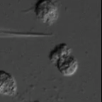
Neutrophil Cells
Micropipette with attractant guides movement
Cells rapidly reorient
Preserve front-back
Weiner’s Lab UCSF

Slide 4
Optogenetics

Slide 5
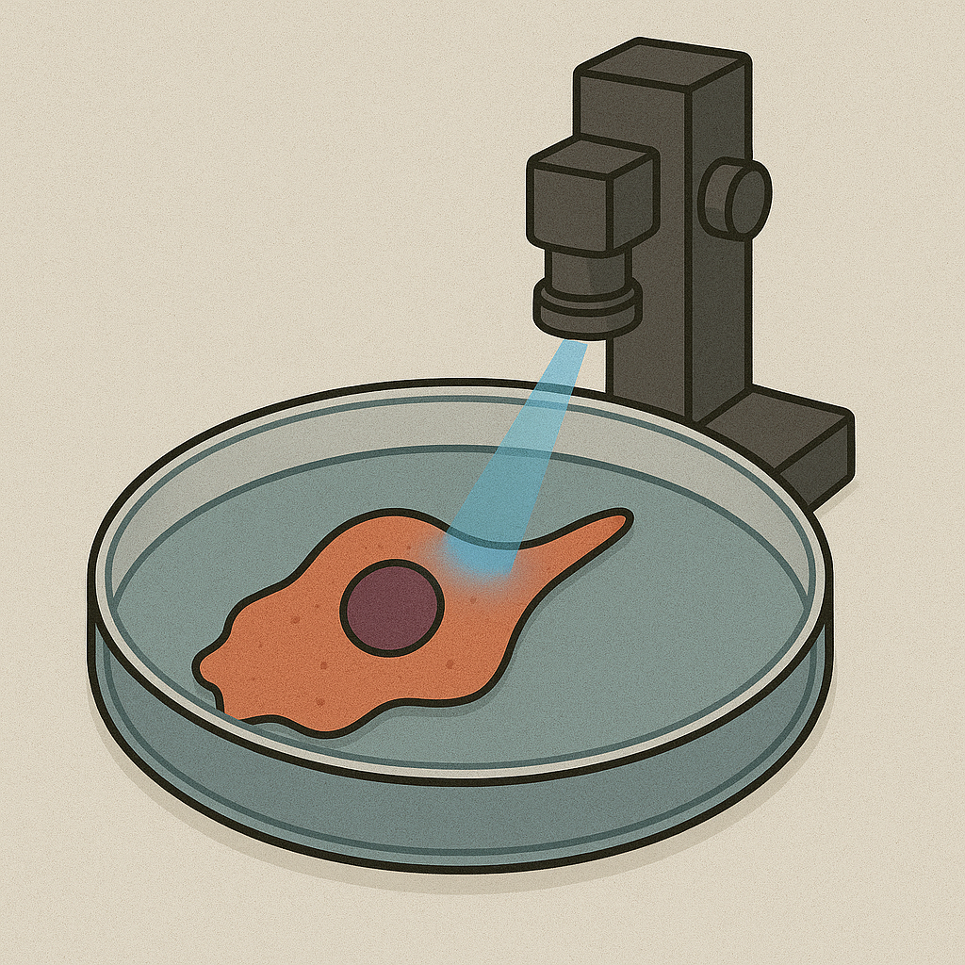
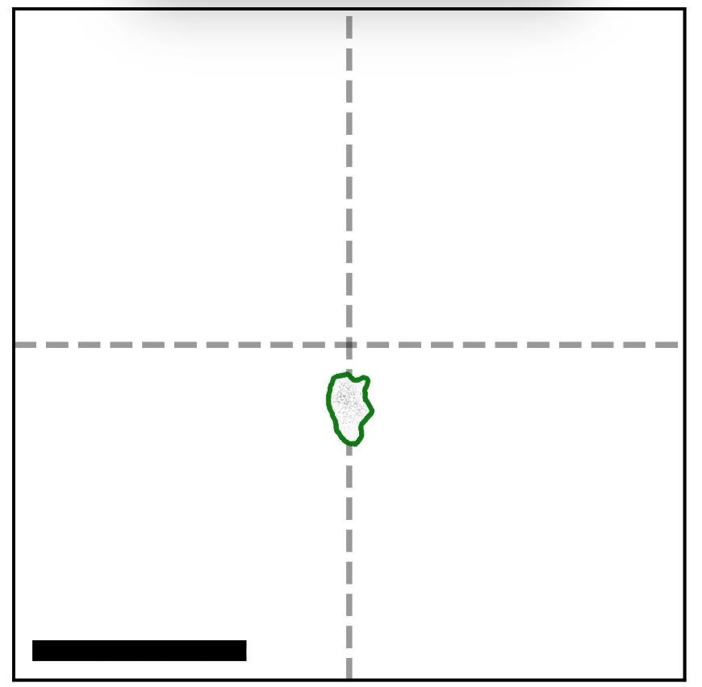
Optogenetics
Generated with ChatGPT 4o
Town, J.P and Weiner, O.D., 2023

Slide 6
How Do Neutrophil Cells Move at All?

Slide 7
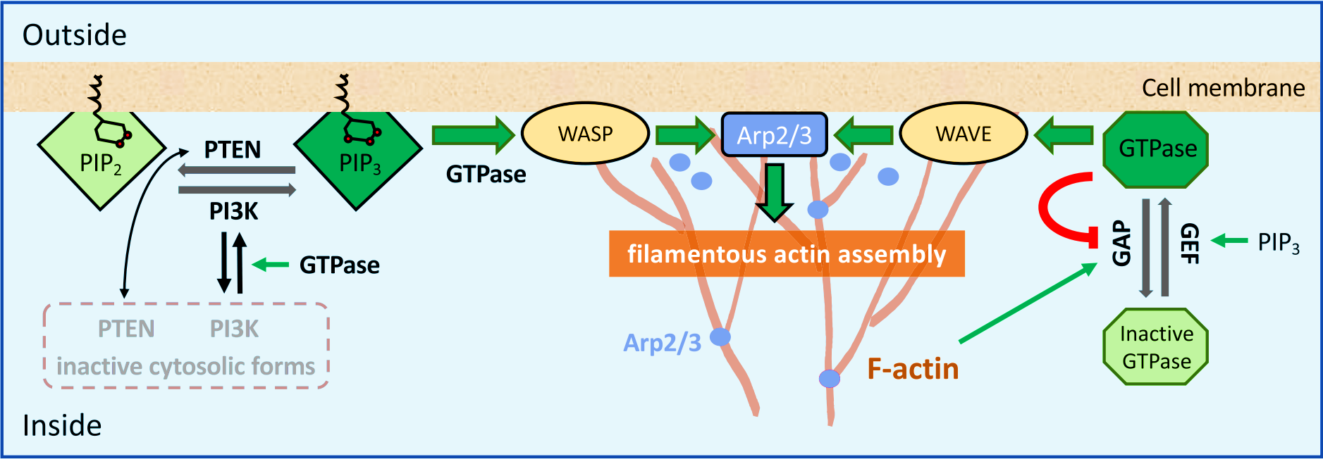
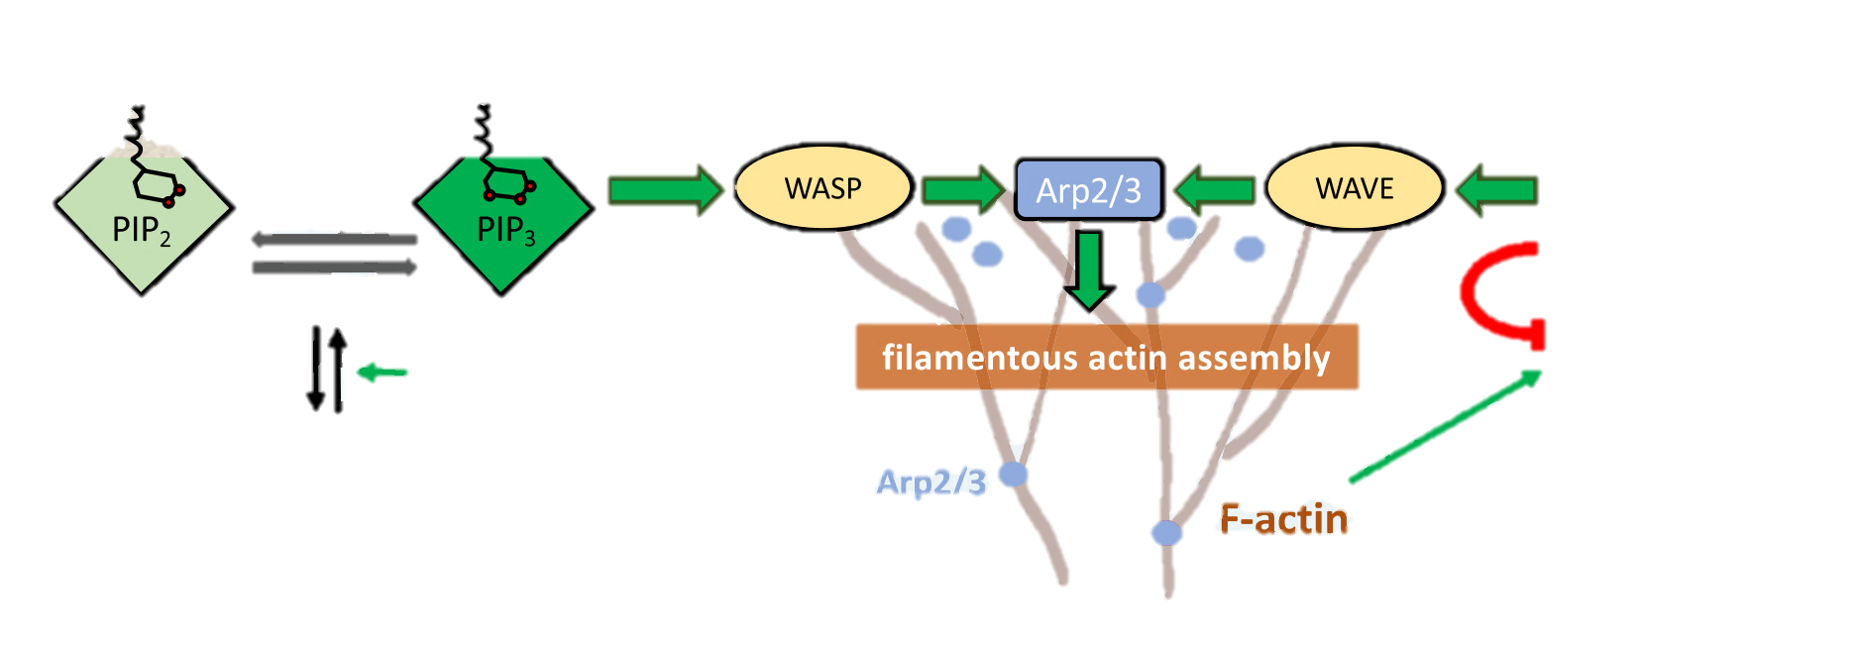
How Do Neutrophil Cells Move at All?
Adapted from: Carsten Beta, Leah Edelstein-Keshet, Nir Gov, Arik Yochelis (2023) From actin waves to mechanism and back: How theory aids biological understanding eLife 12:e87181

Slide 8
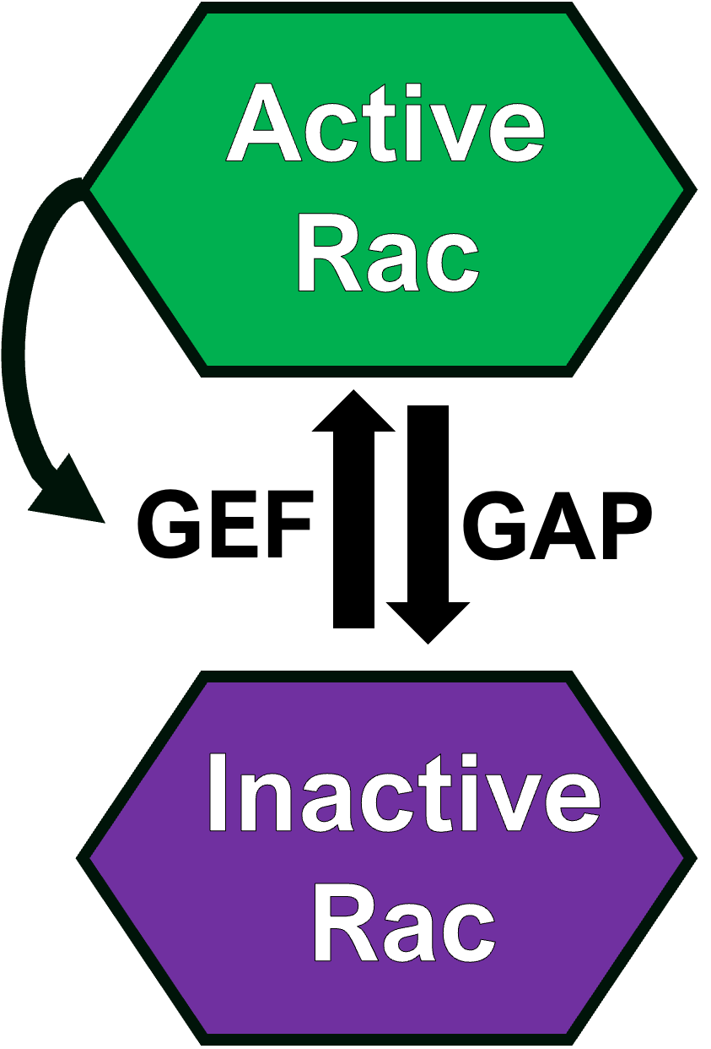
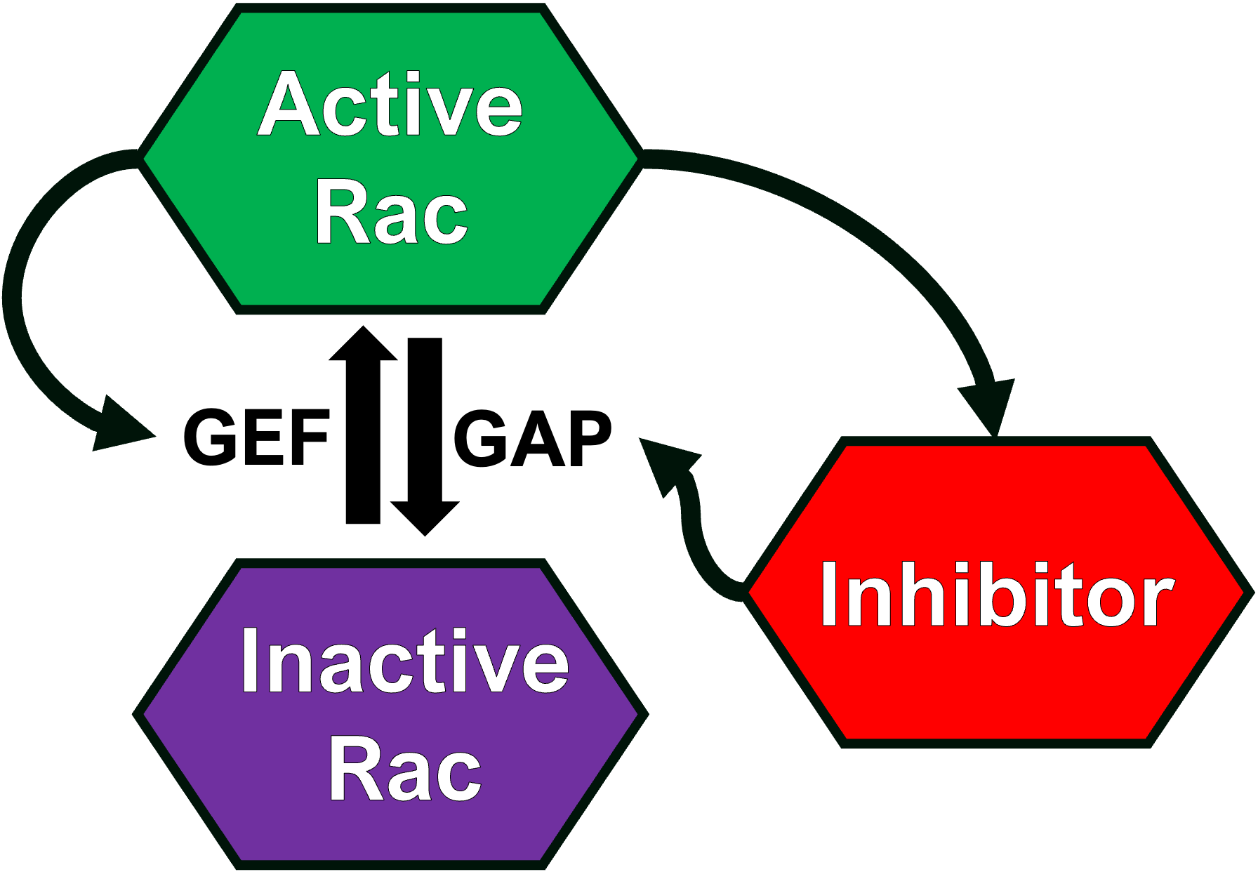
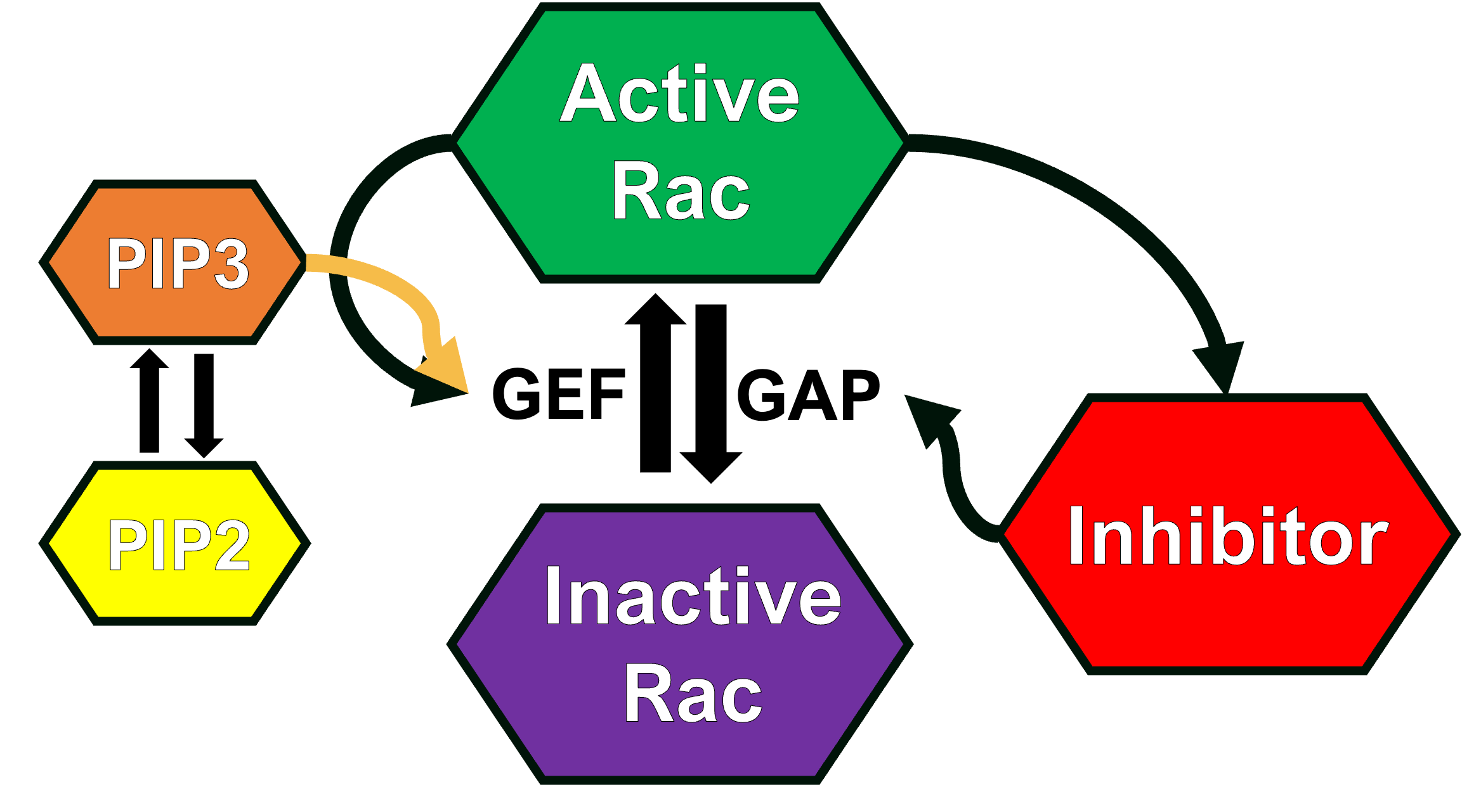
Circuits
WP MODEL
WPI MODEL
WPI-PIP3 MODEL

Slide 9
Simulation Framework
Active
Rac
Protrusion
GEF
GAP
Inactive
Rac

Slide 10
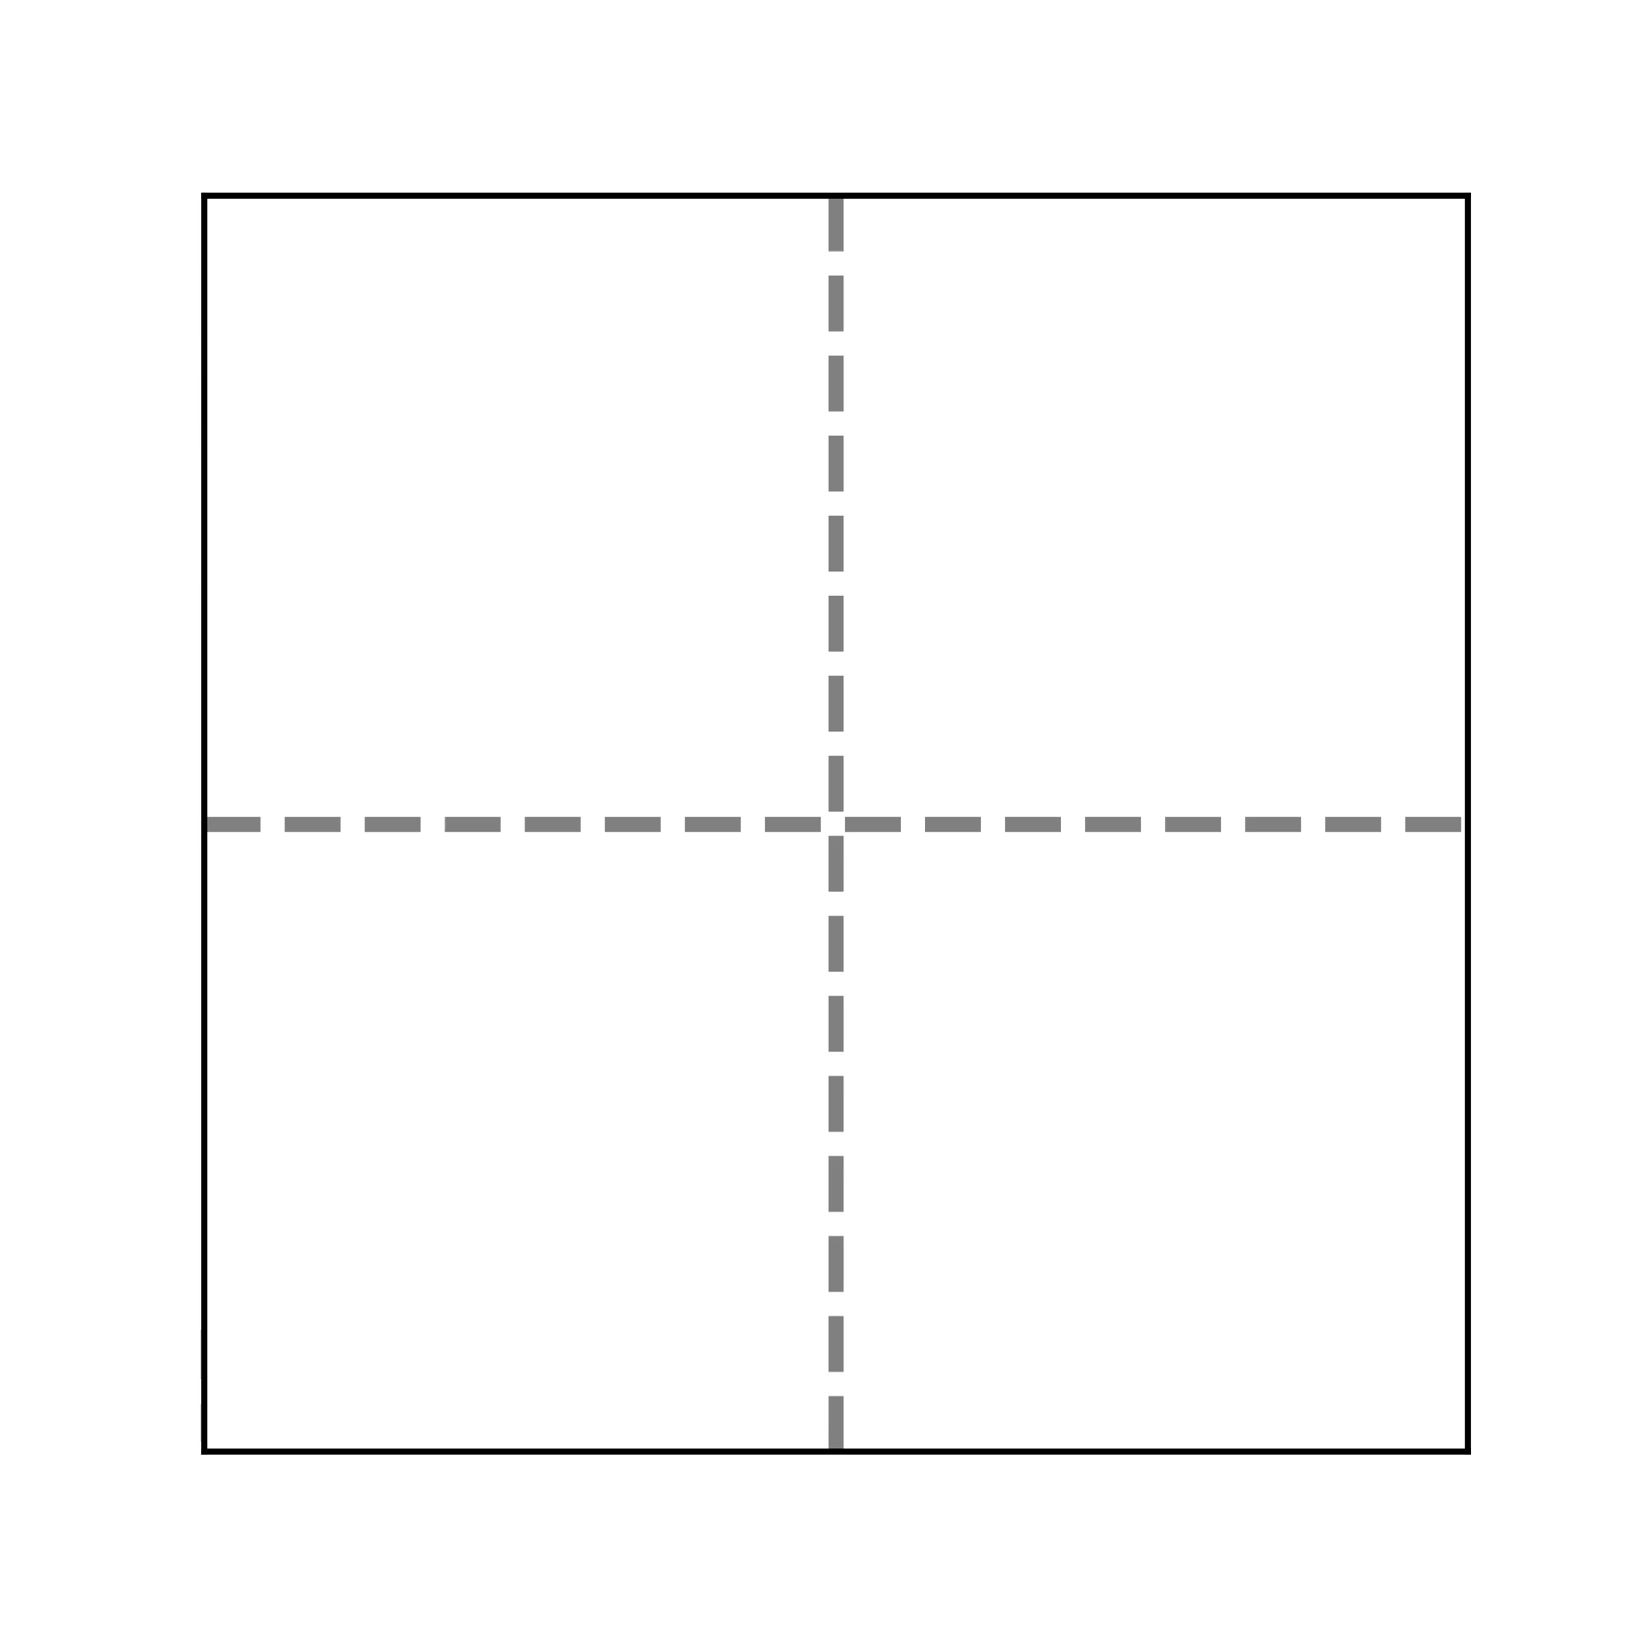
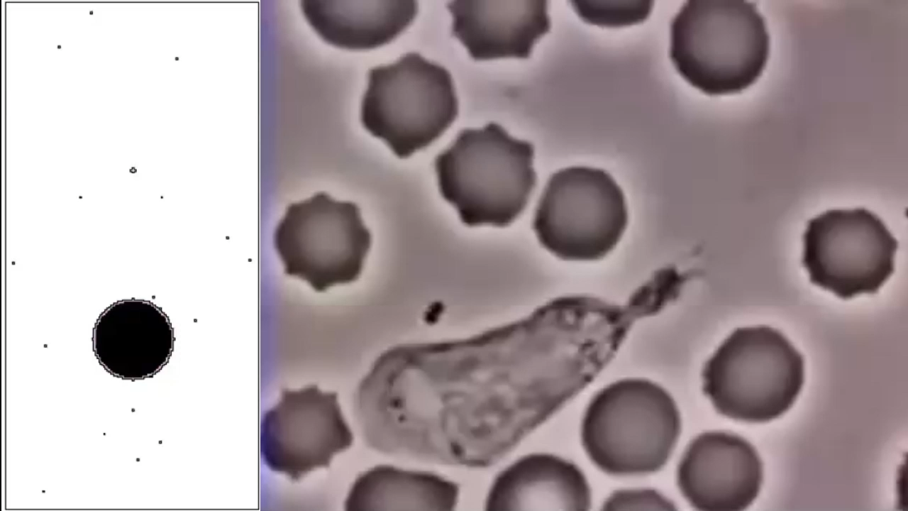
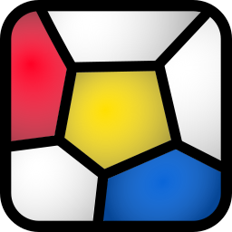
Simulation Framework
morpheus.gitlab.io

Slide 11
Wave-Pinning (WP) Model

Slide 12
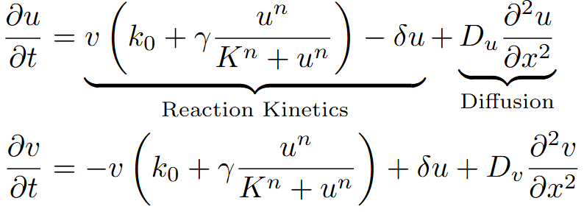
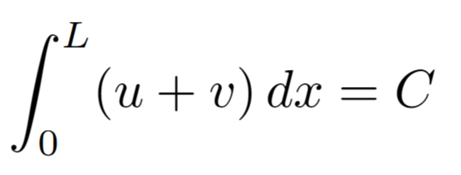

Wave-Pinning (WP) Model
Active
Rac
GEF
GAP
Inactive
Rac
Jilkine, A, Mori, Y and LEK, 2008

Slide 13
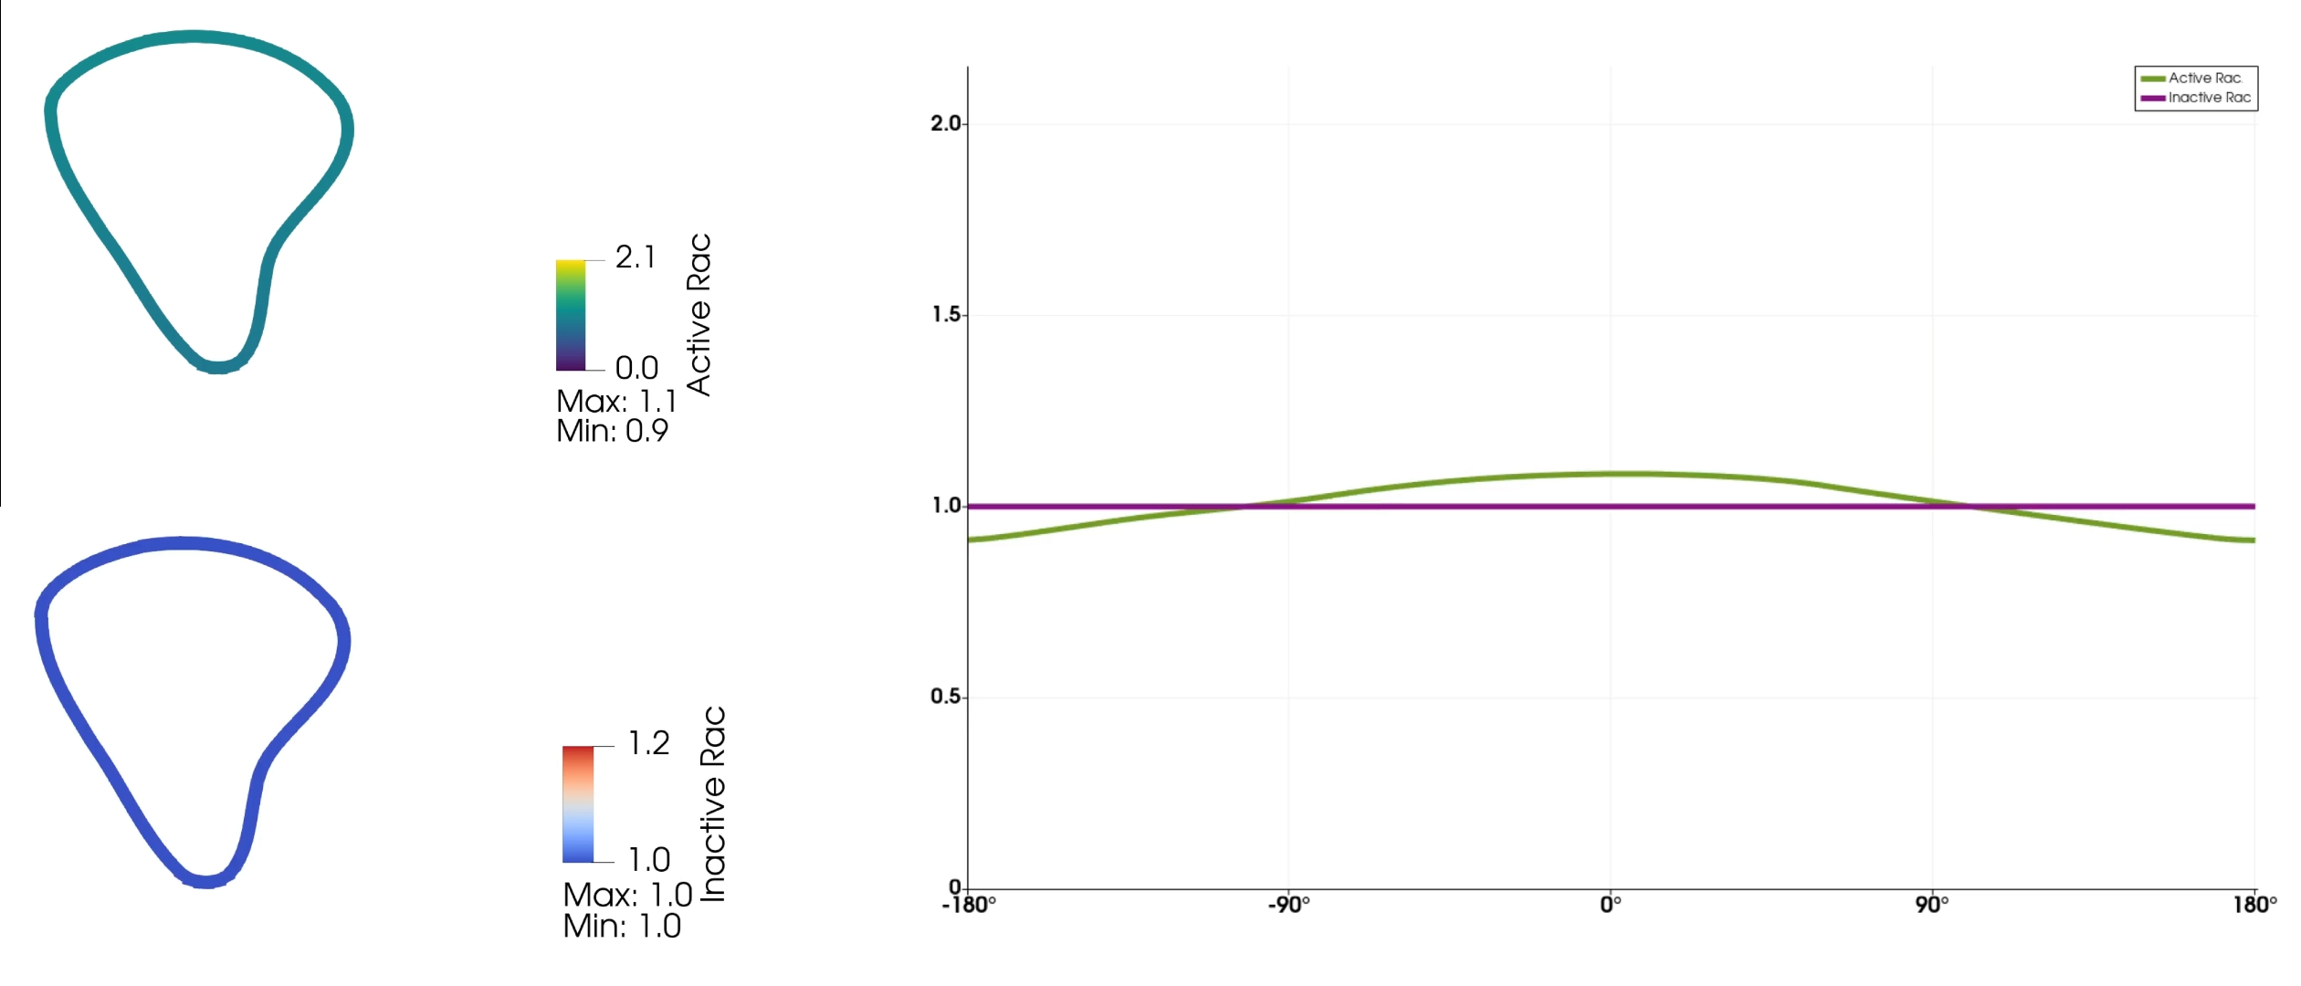
Wave-Pinning (WP) Model

Slide 14
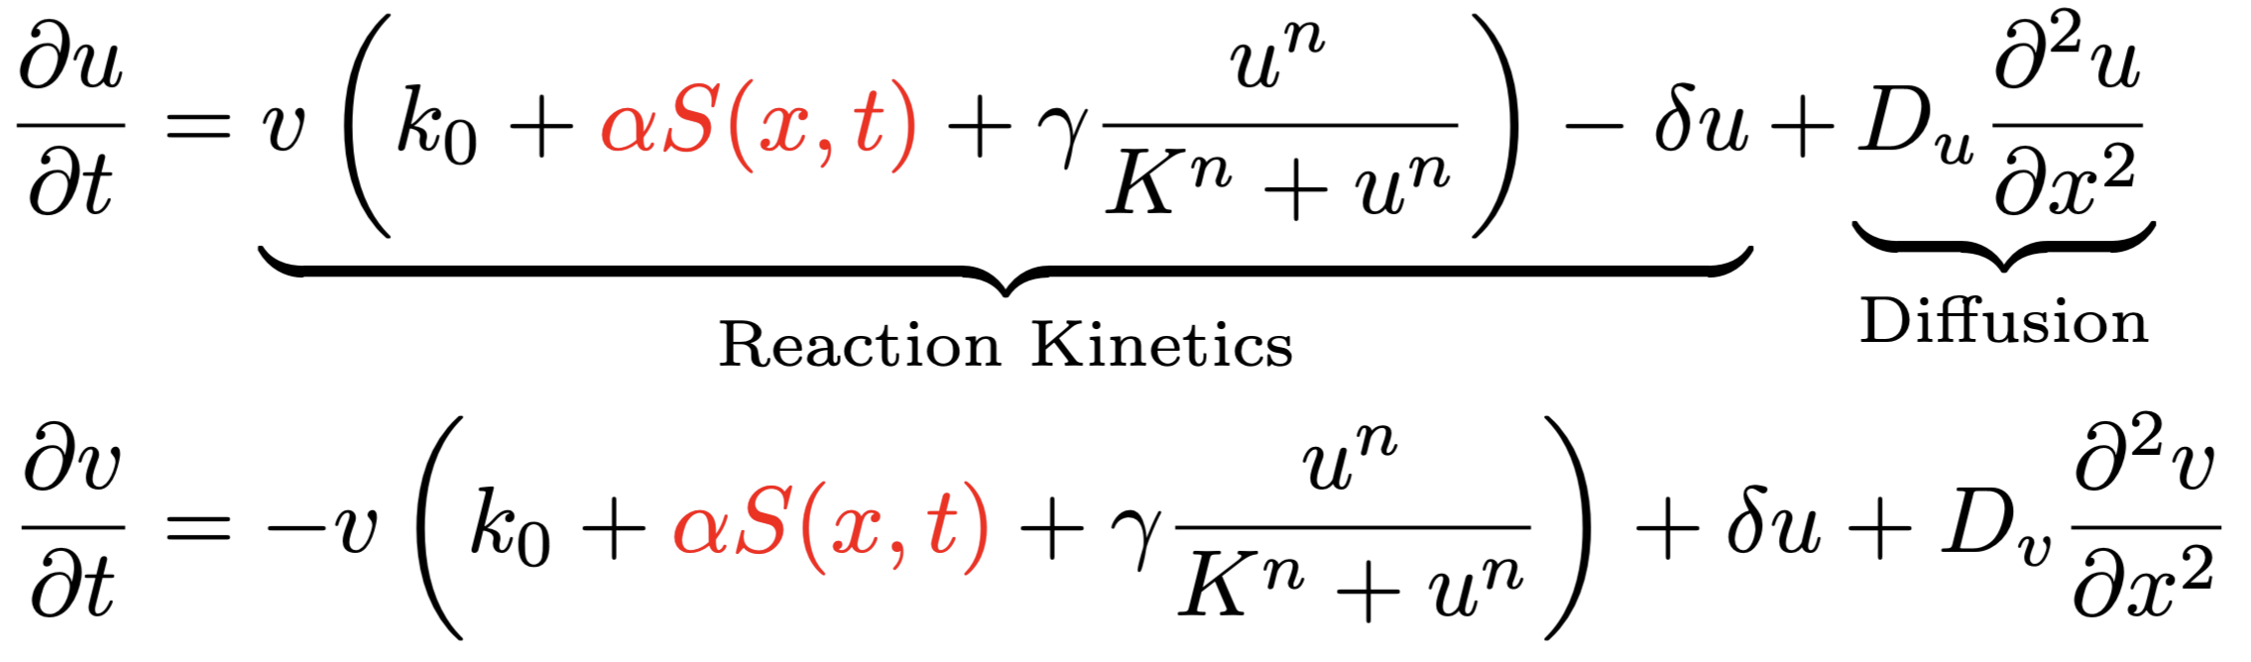

Wave-Pinning (WP) Model
Active
Rac
Light
GEF
GAP
Inactive
Rac

Slide 15
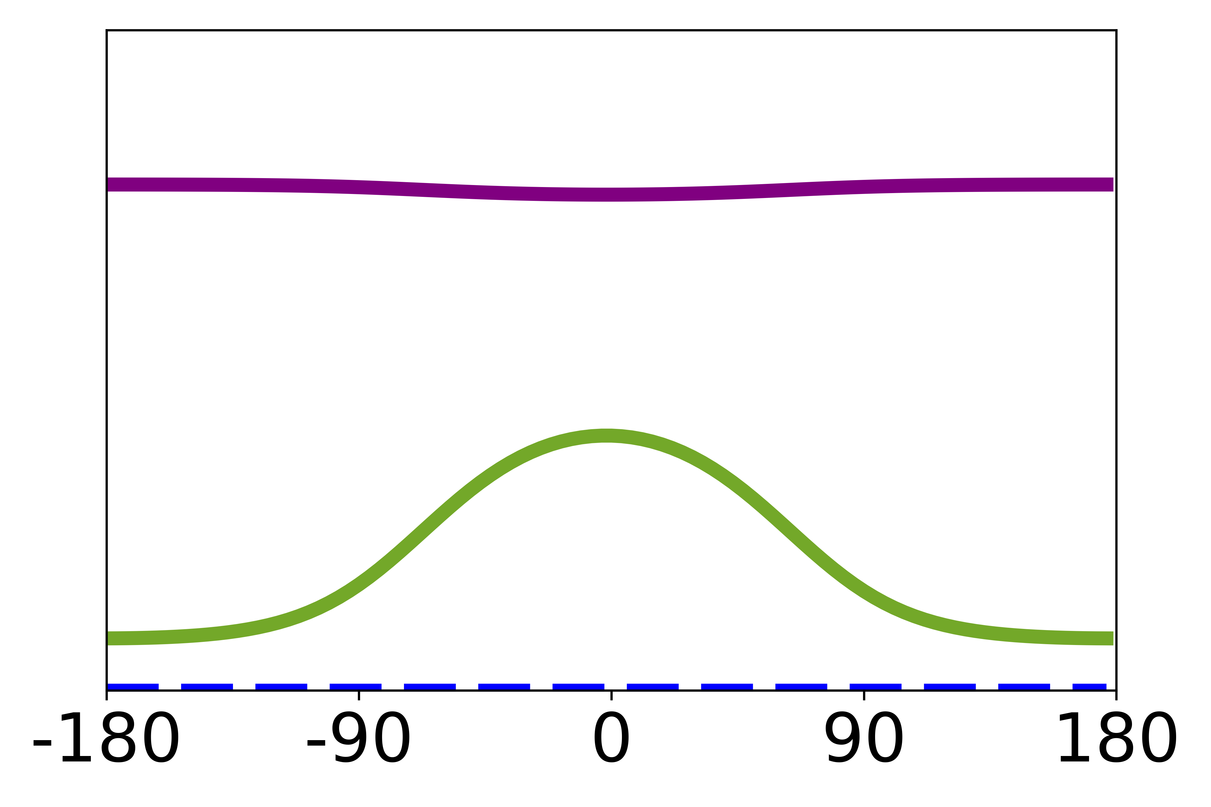
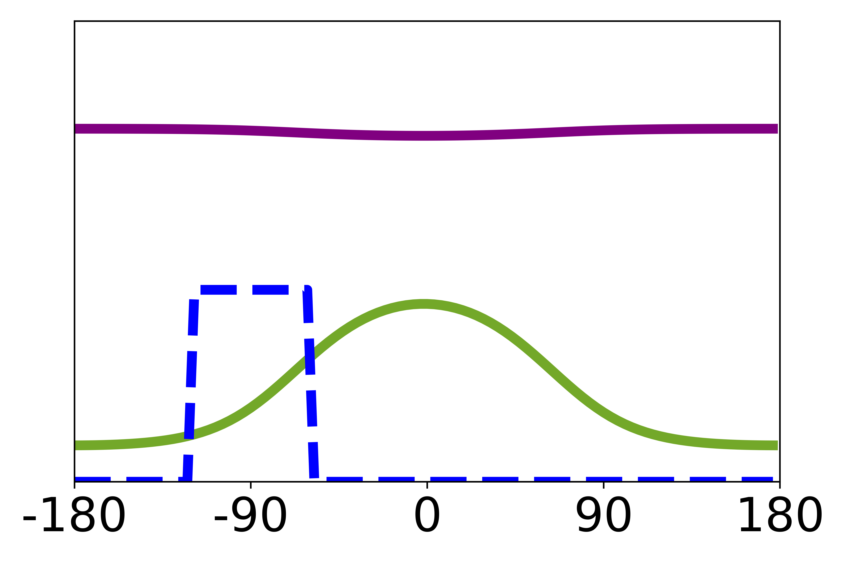
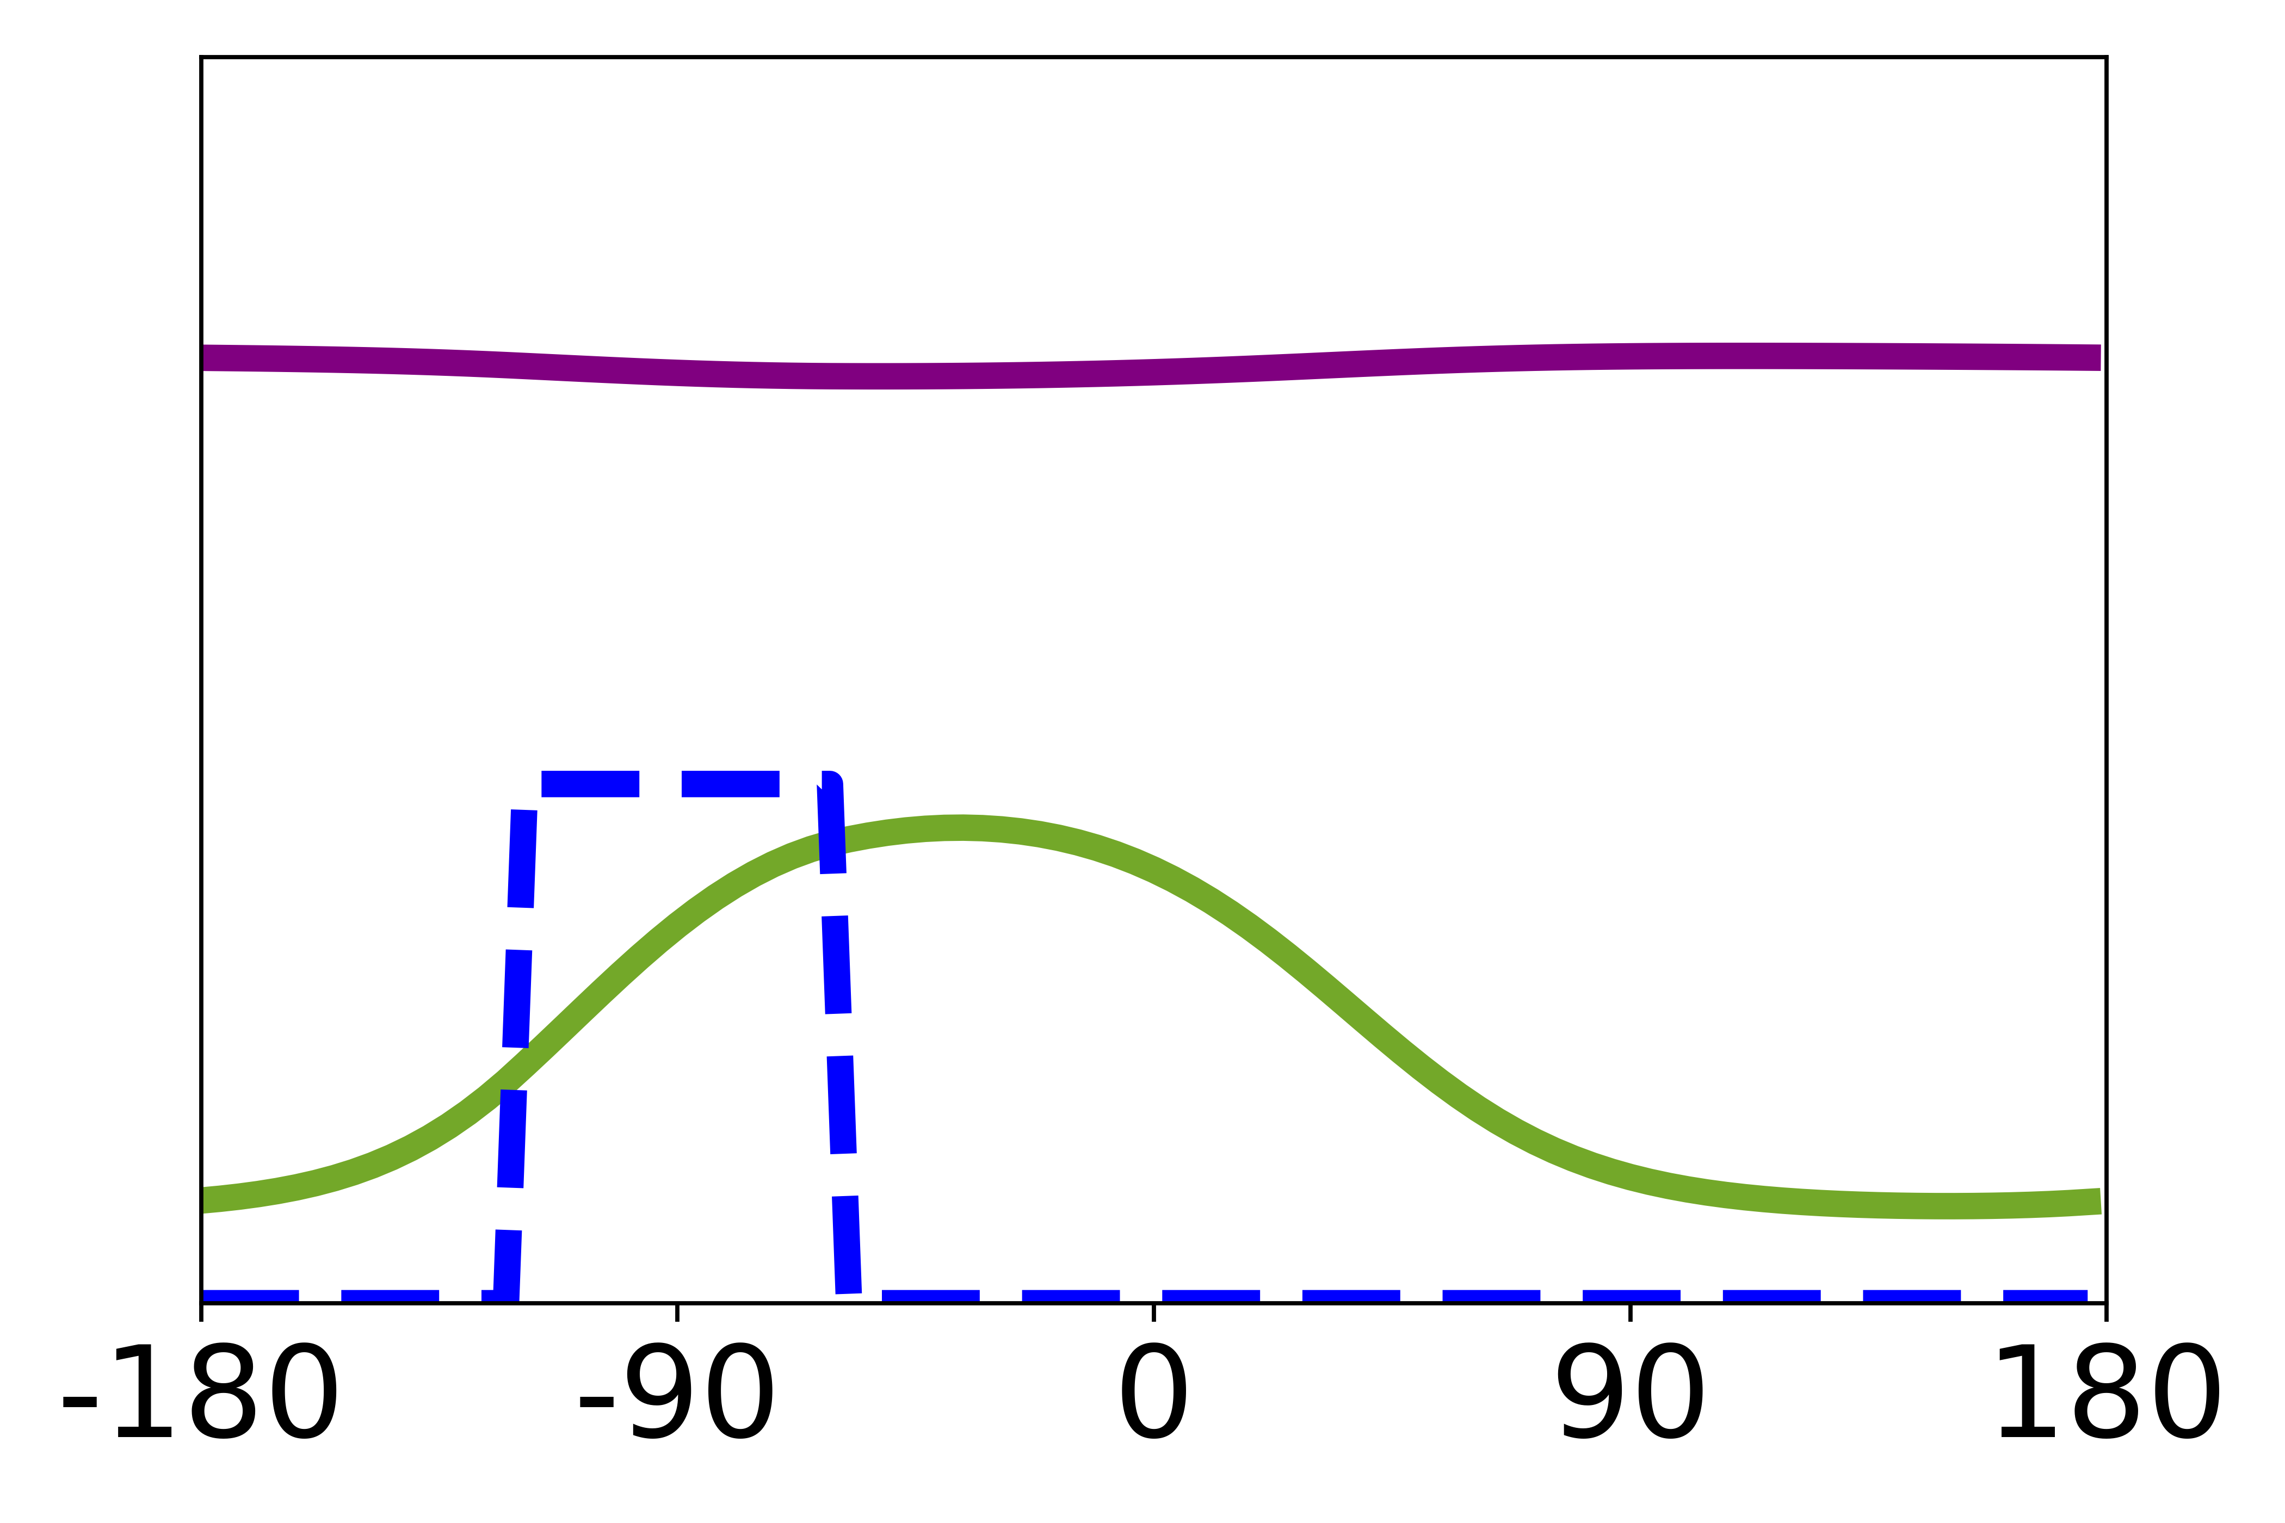
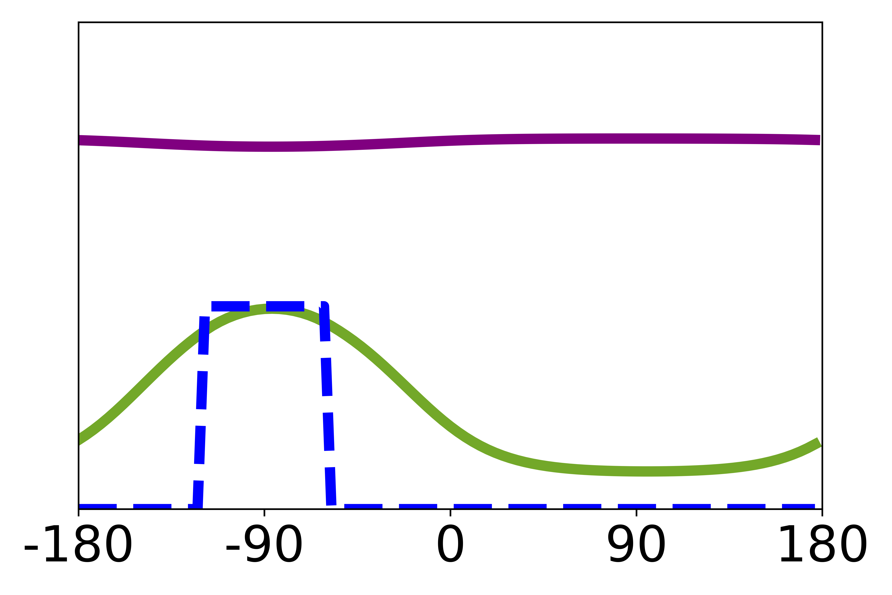
Wave-Pinning (WP) Model
Active
Rac
Light
GEF
GAP
Inactive
Rac

Slide 16
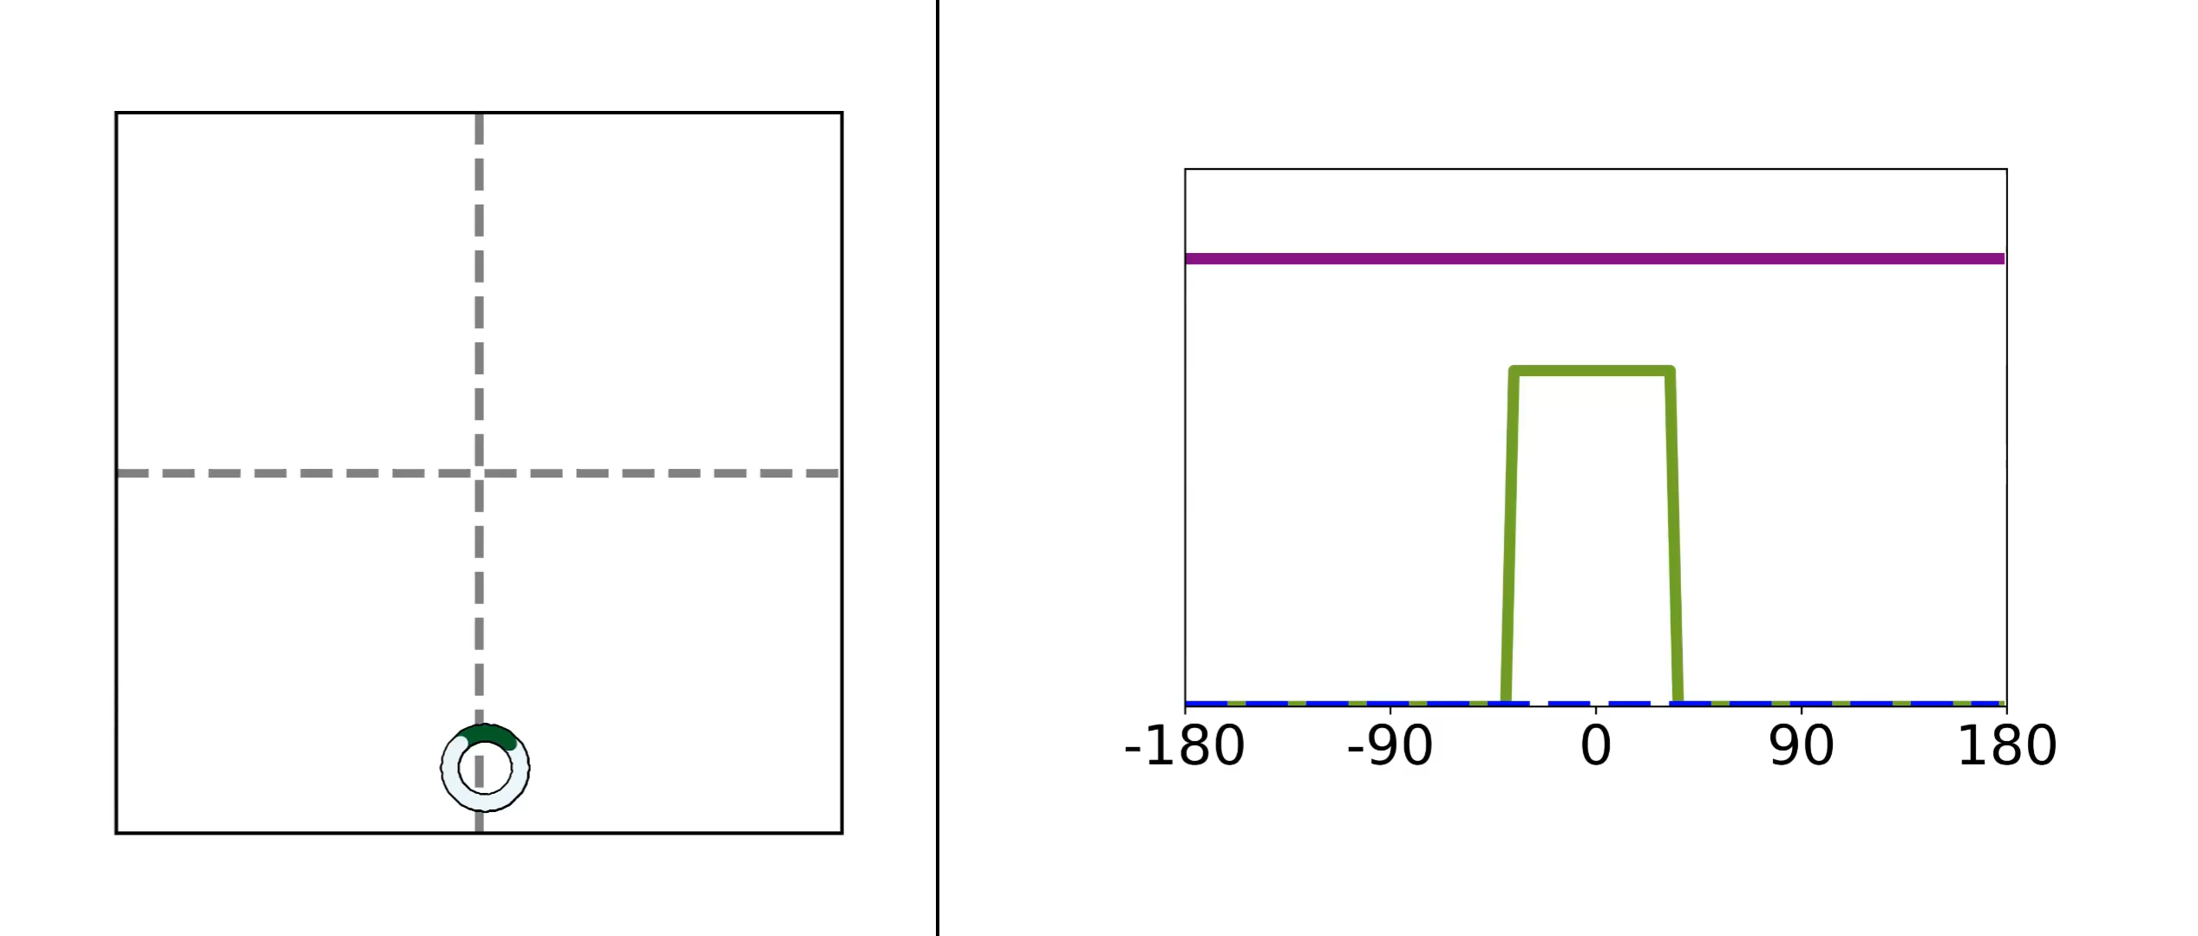
Wave-Pinning (WP) Model

Slide 17
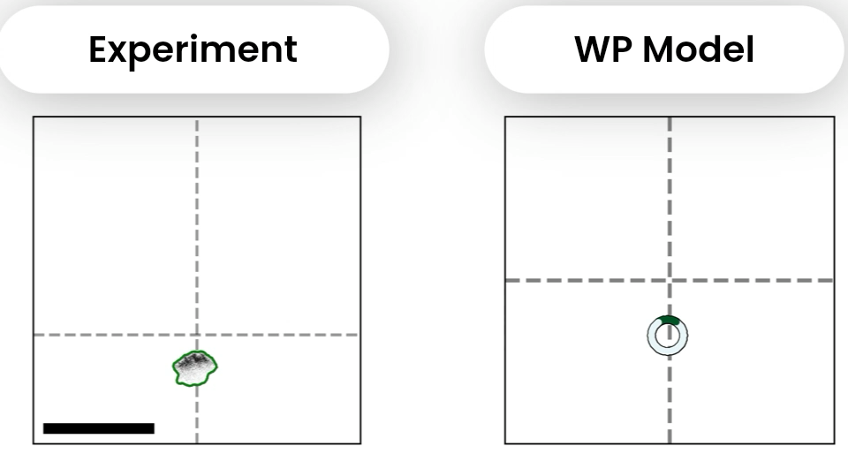
Wave-Pinning (WP) Model
Algorta J., Town, J.P., Weiner, O.D. and L.E.K., 2025

Slide 18
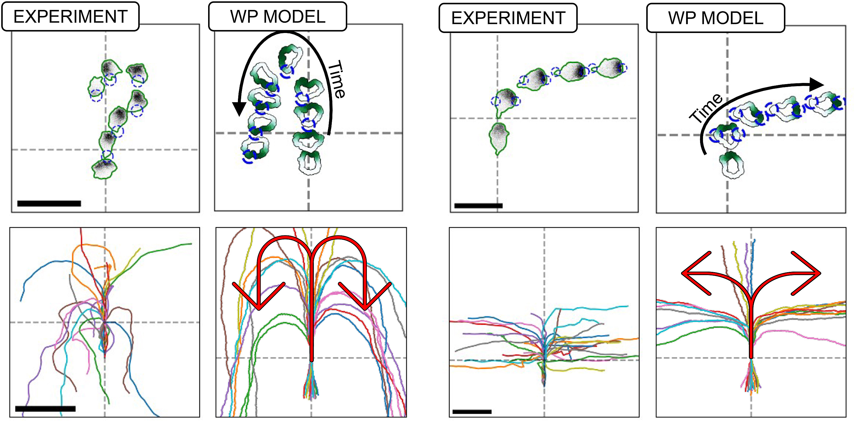
Wave-Pinning (WP) Model
Algorta J., Town, J.P., Weiner, O.D. and L.E.K., 2025

Slide 19
Evidence For a Negative Feedback Loop

Slide 20
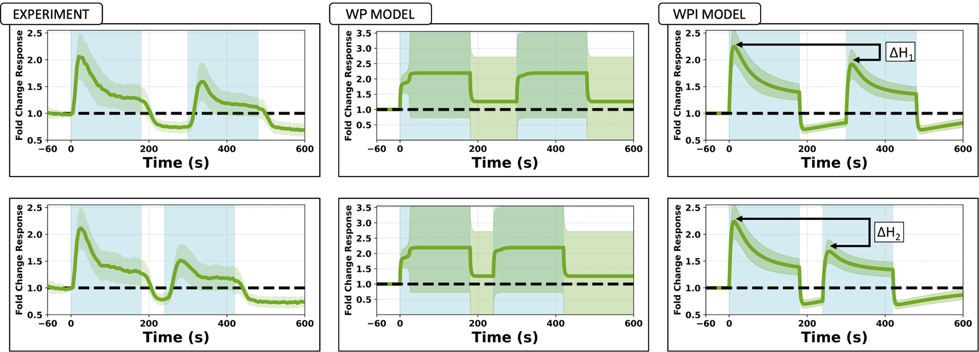
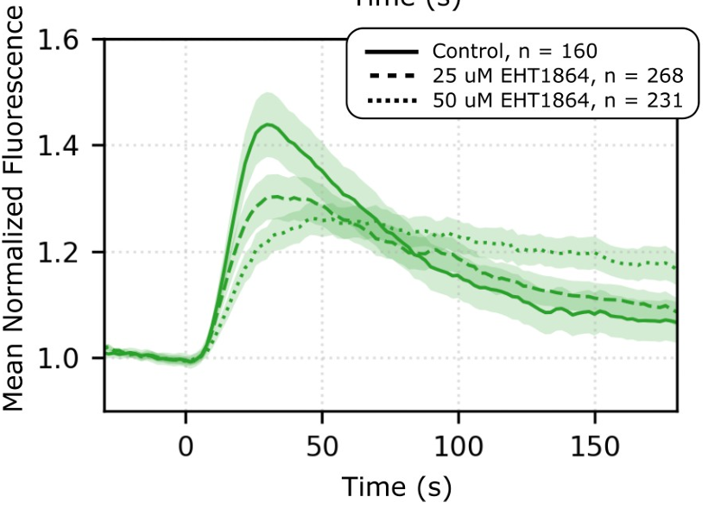
Evidence For a Negative Feedback Loop
Town, J.P. and Weiner, O.D., 2023

Slide 21

Evidence For a Negative Feedback Loop
Algorta J., Town, J.P., Weiner, O.D. and L.E.K., 2025

Slide 22
Wave-Pinning with Inhibitor (WPI) Model

Slide 23
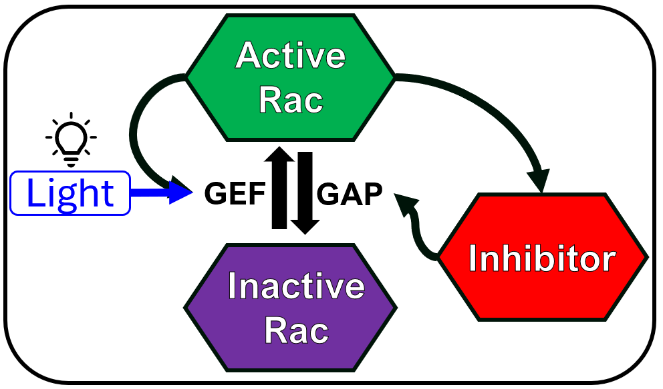
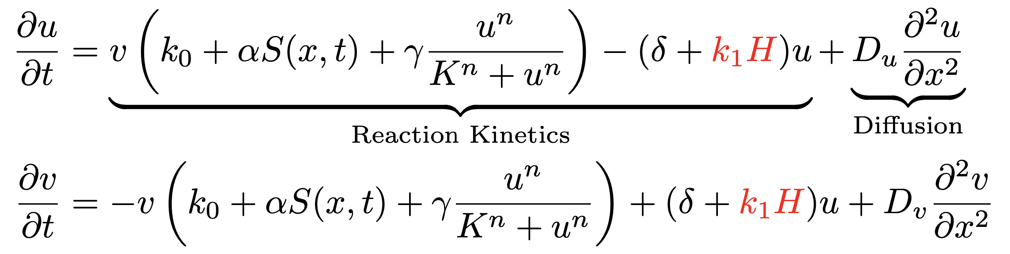
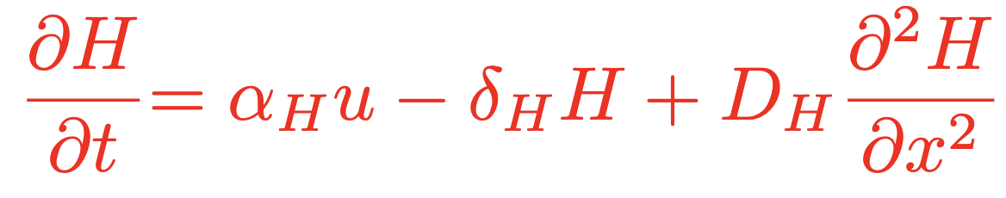
Wave-Pinning with Inhibitor (WPI) Model

Slide 24
Wave-Pinning with Inhibitor (WPI) Model
Algorta J., Town, J.P., Weiner, O.D. and L.E.K., 2025

Slide 25
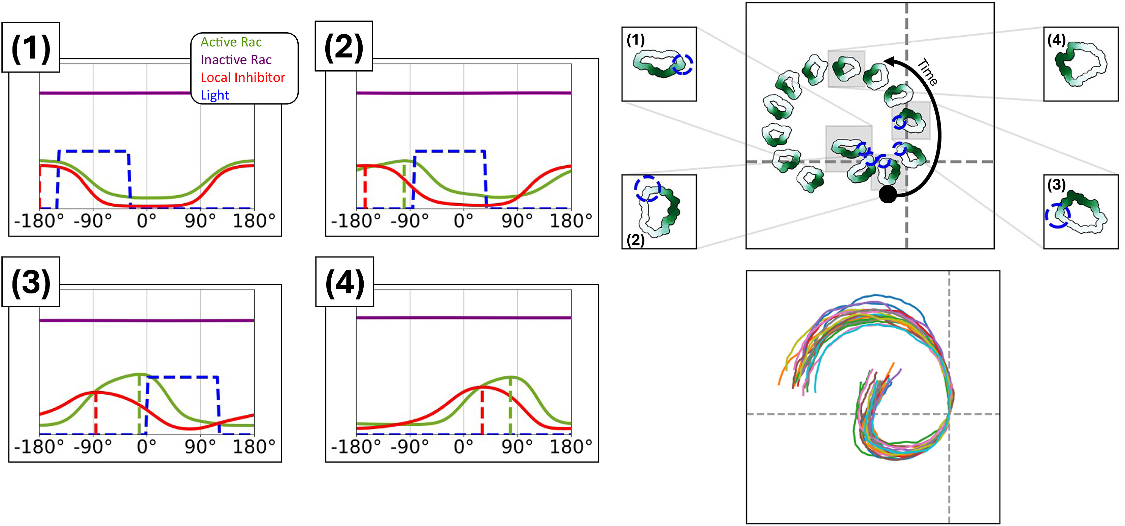
Wave-Pinning with Inhibitor (WPI) Model
Algorta J., Town, J.P., Weiner, O.D. and L.E.K., 2025

Slide 26
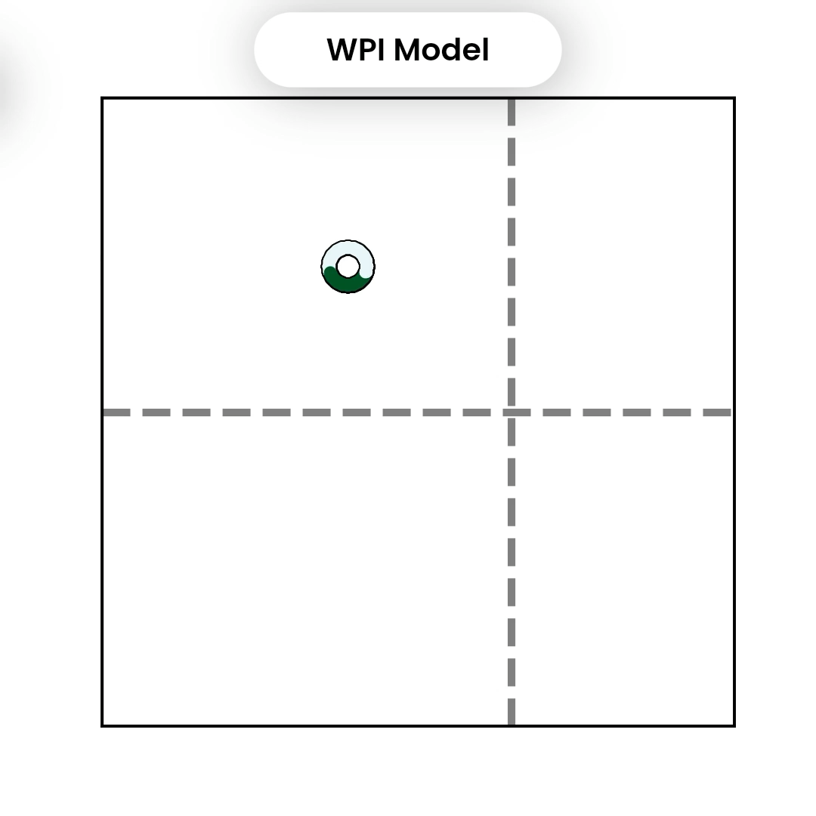
Wave-Pinning with Inhibitor (WPI) Model

Slide 27
Exotic Cell Path

Slide 28
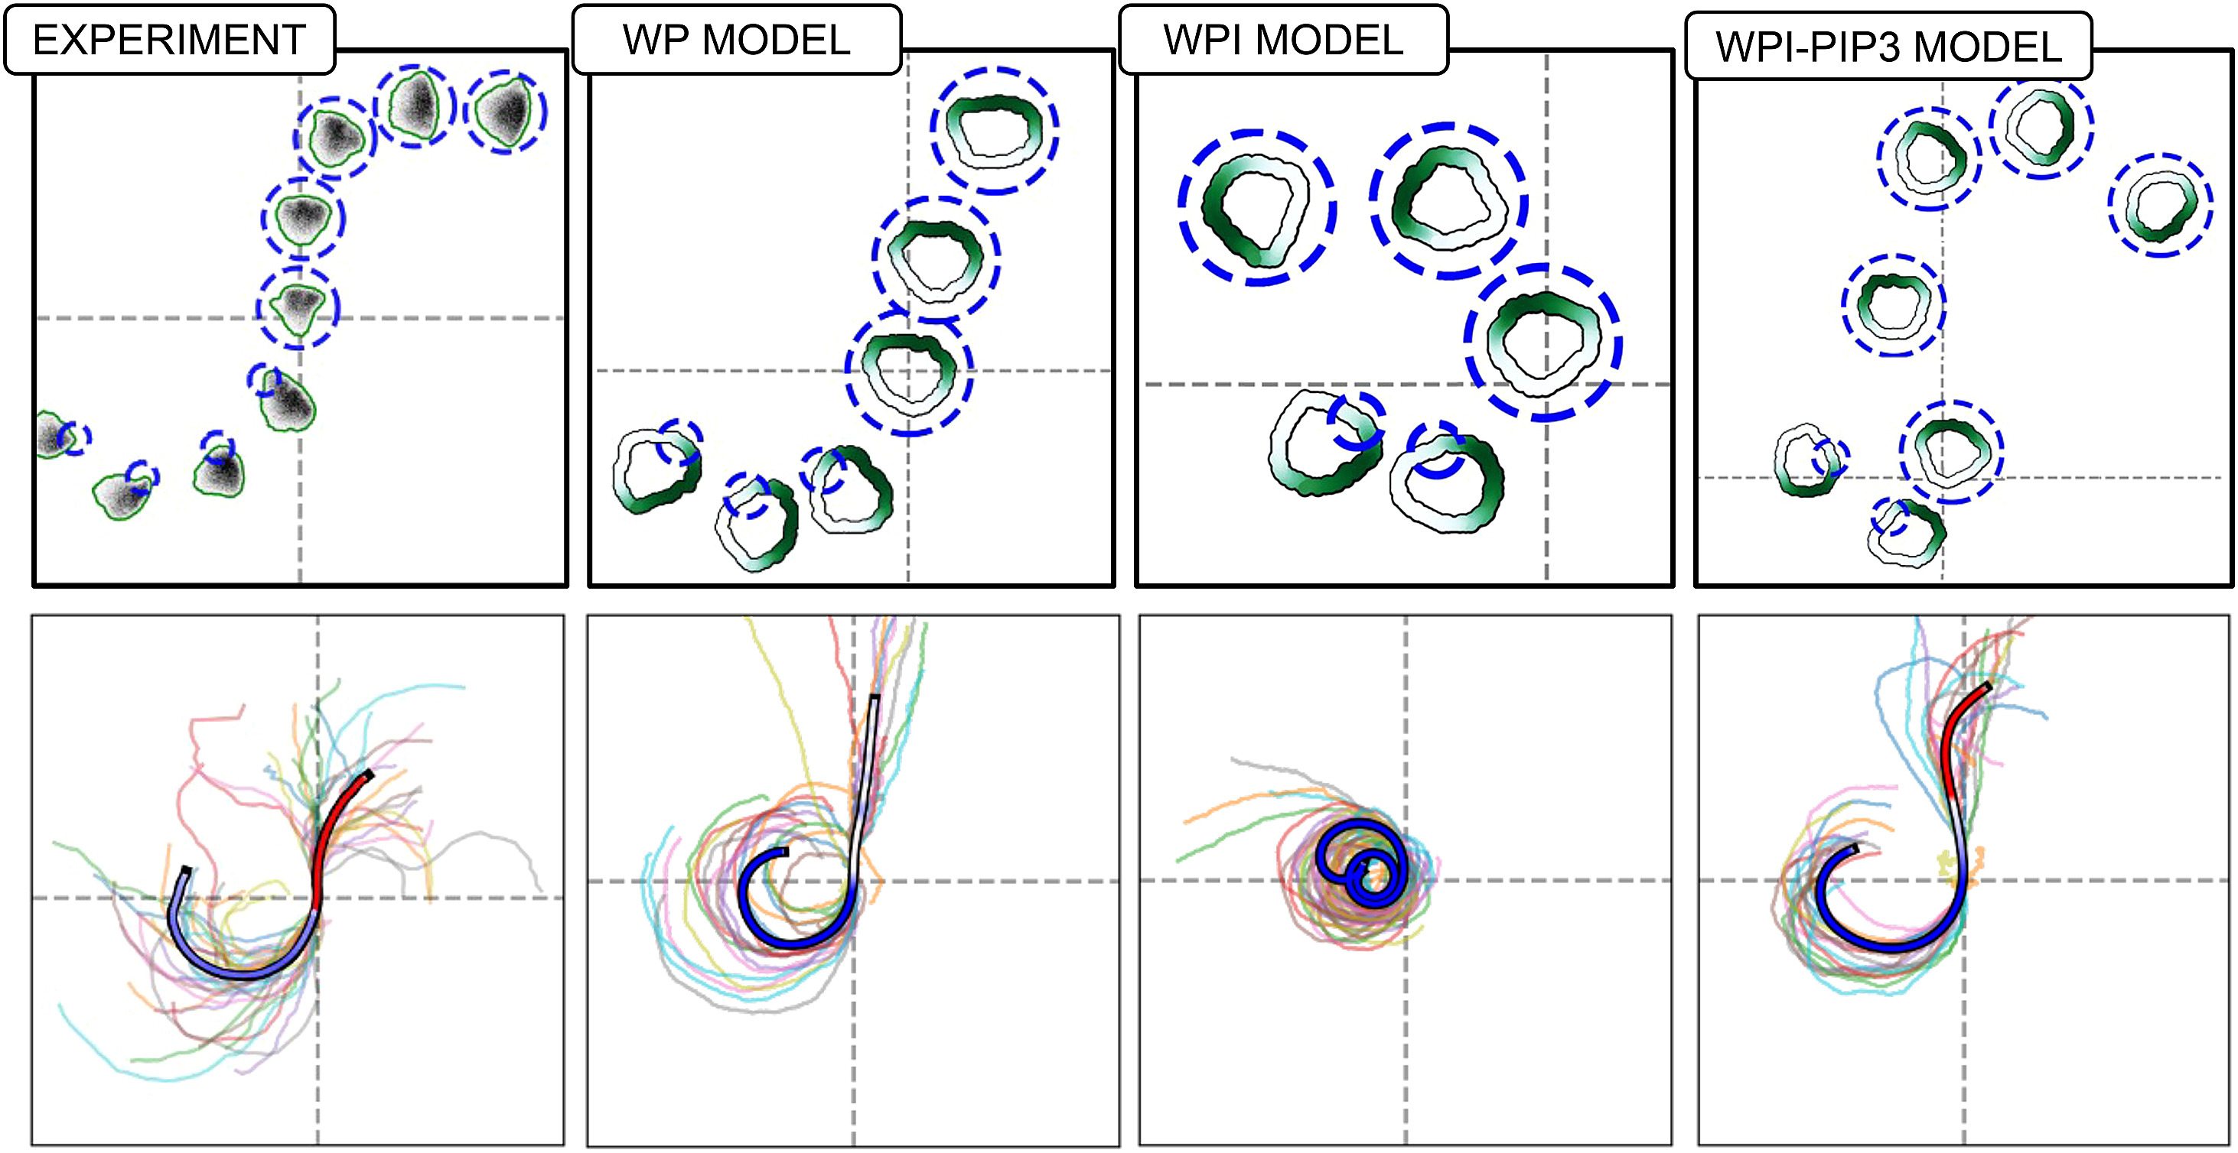
Exotic Cell Path

Slide 29
Wave-Pinning with Inhibitor and PIP3
(WPI-PIP3) Model

Slide 30
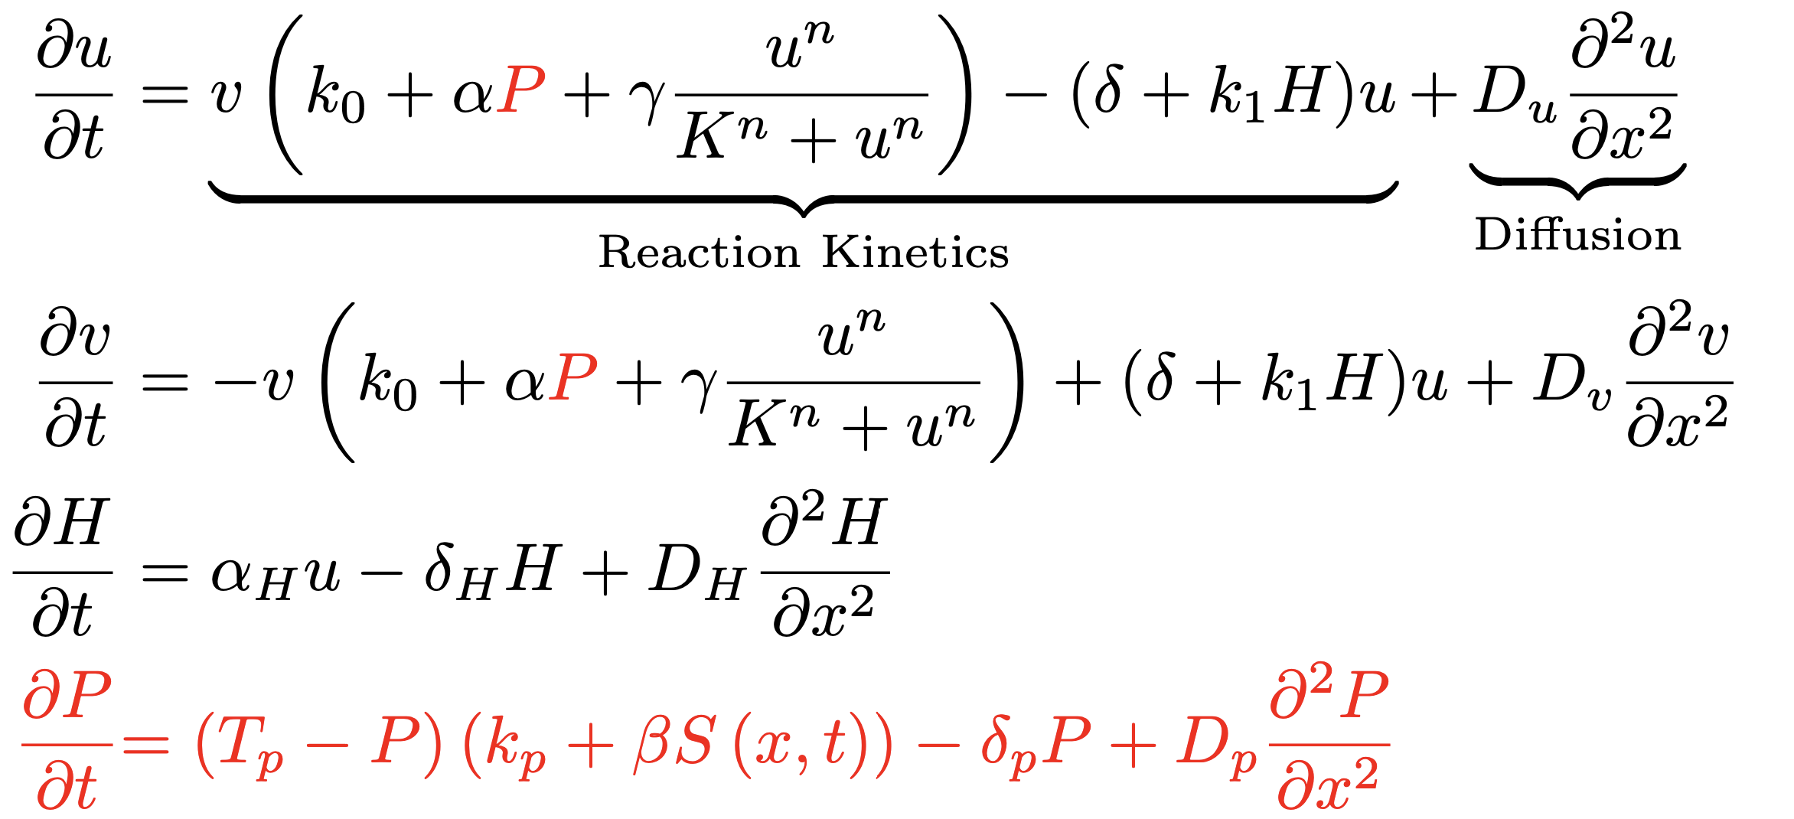
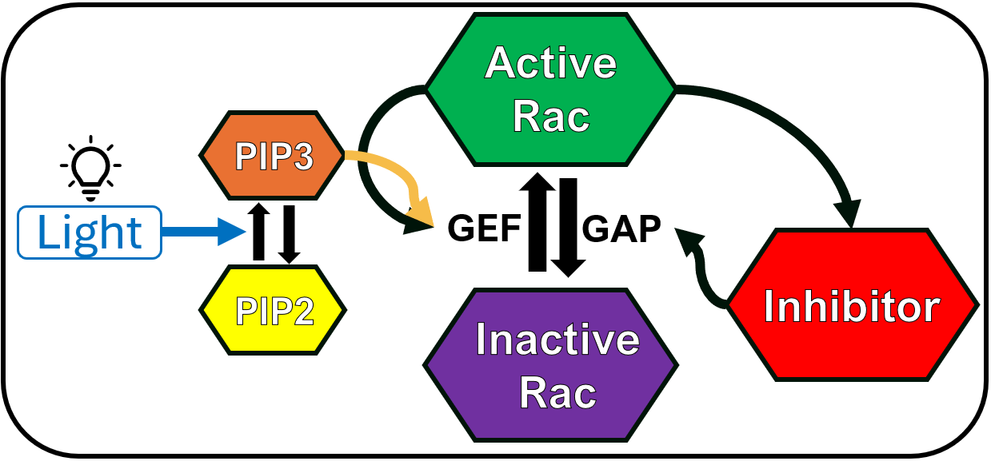
WPI-PIP3 Model

Slide 31
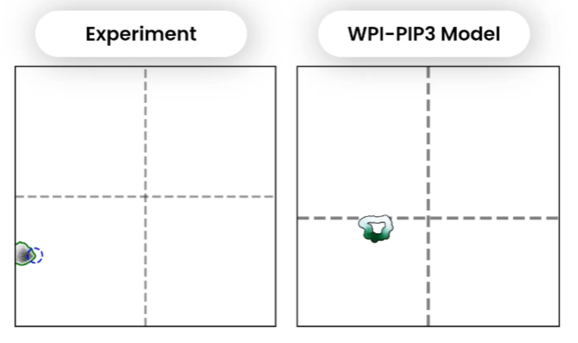
WPI-PIP3 Model

Slide 32
WPI-PIP3 Model
Algorta J., Town, J.P., Weiner, O.D. and L.E.K., 2025

Slide 33
Back to Chemotaxis

Slide 34
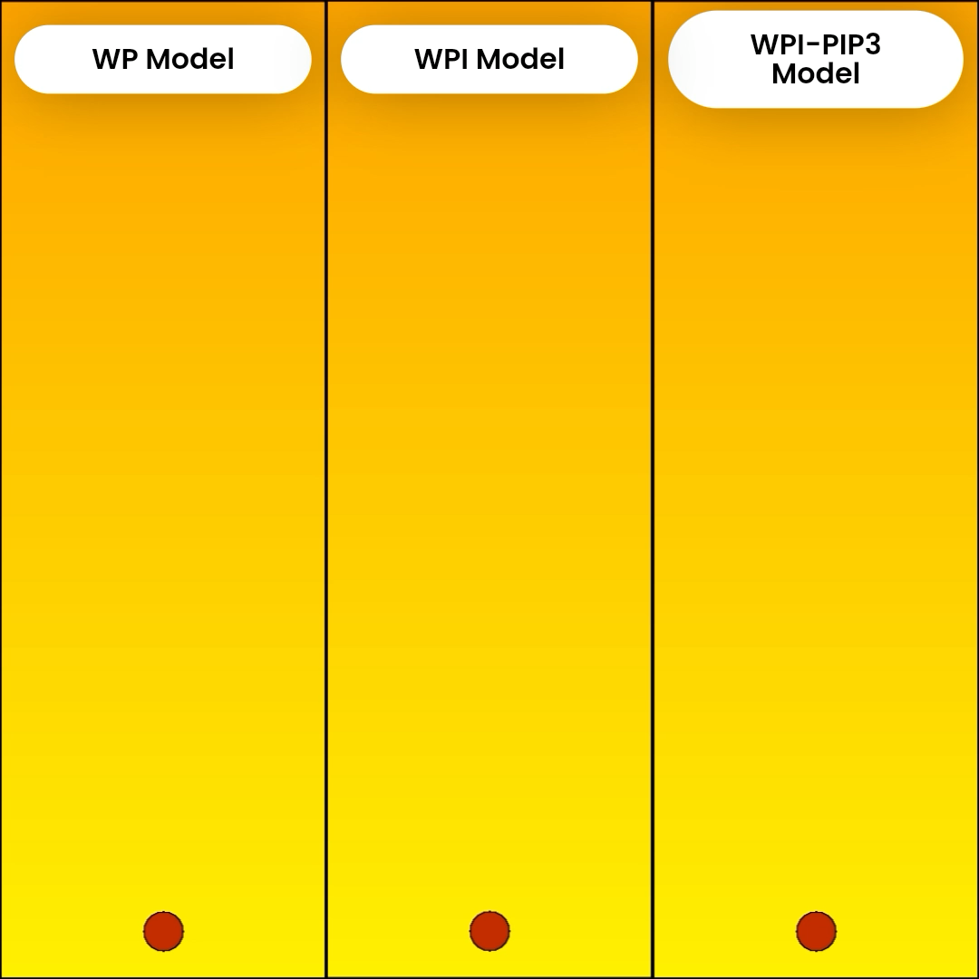
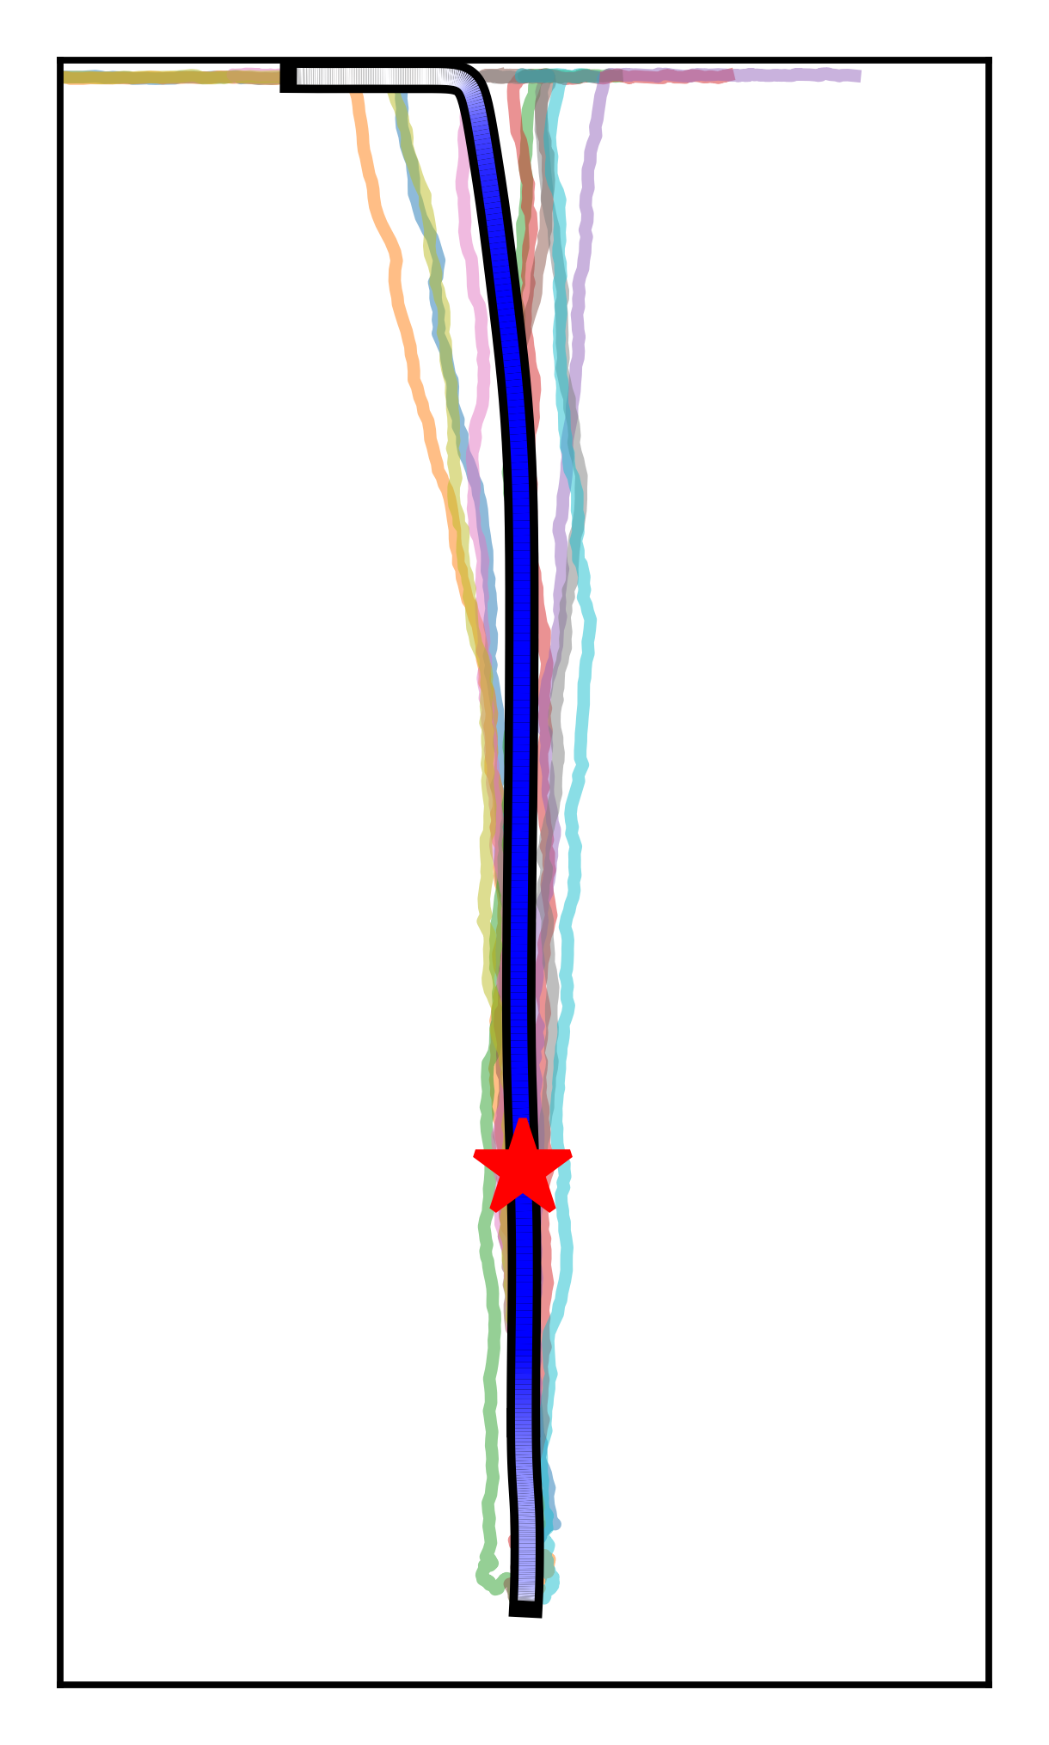
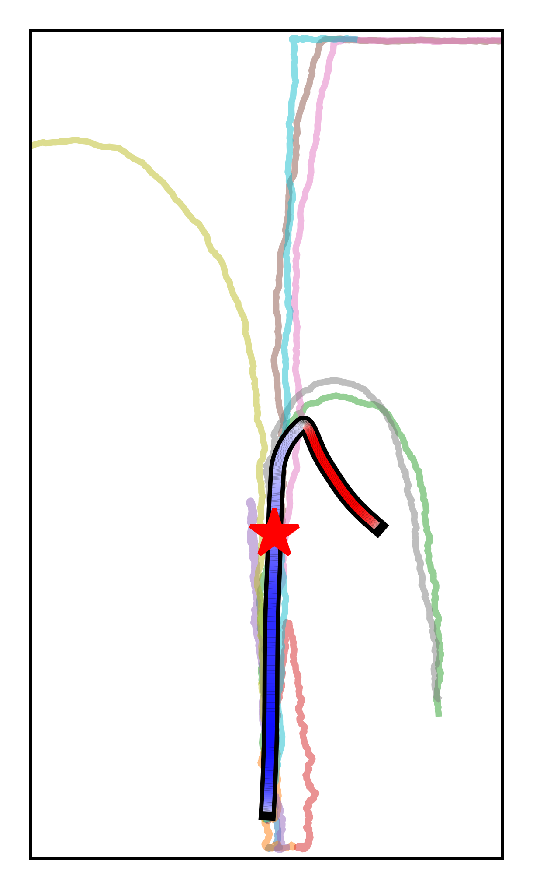
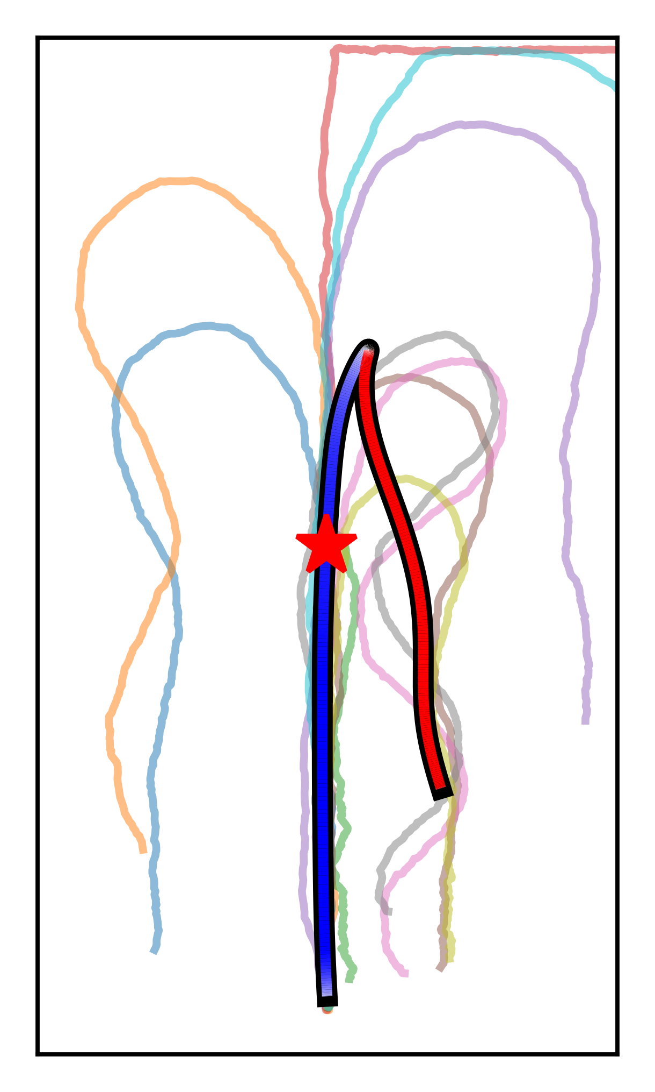
Back to Chemotaxis
Algorta J., Town, J.P., Weiner, O.D. and L.E.K., 2025

Slide 35
Cells on Tracks

Slide 36
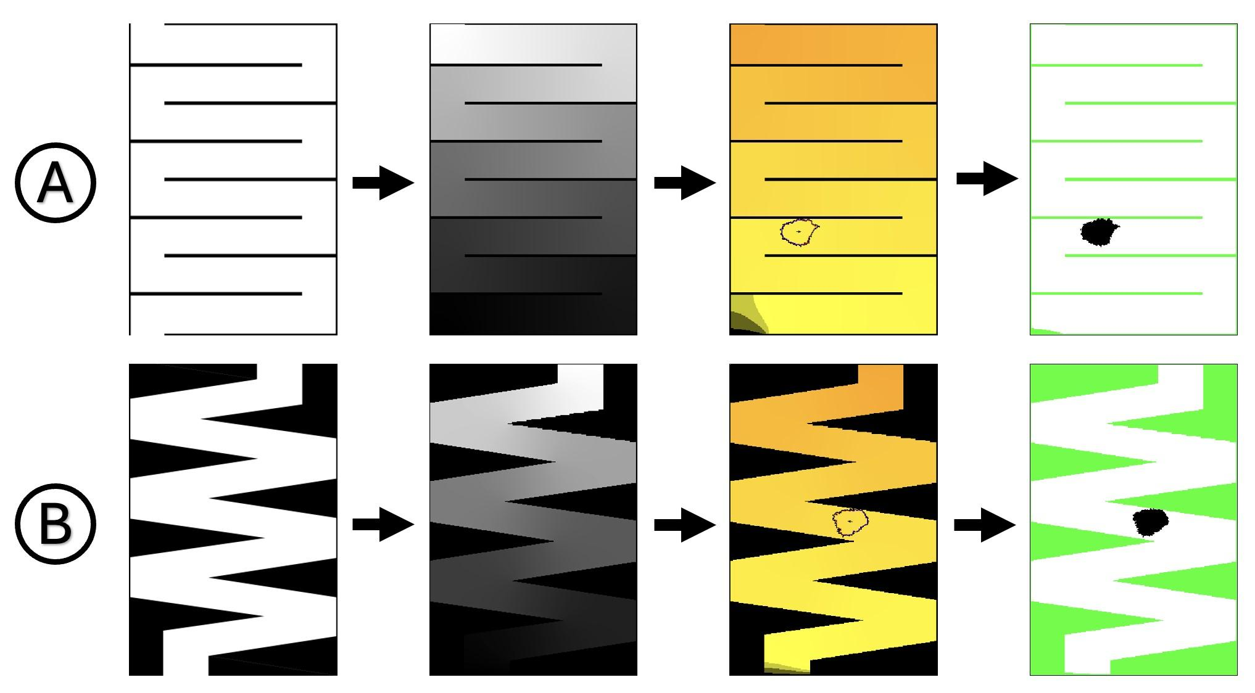

Cells on Tracks
Edwin Huras, UBC Masters student

Slide 37
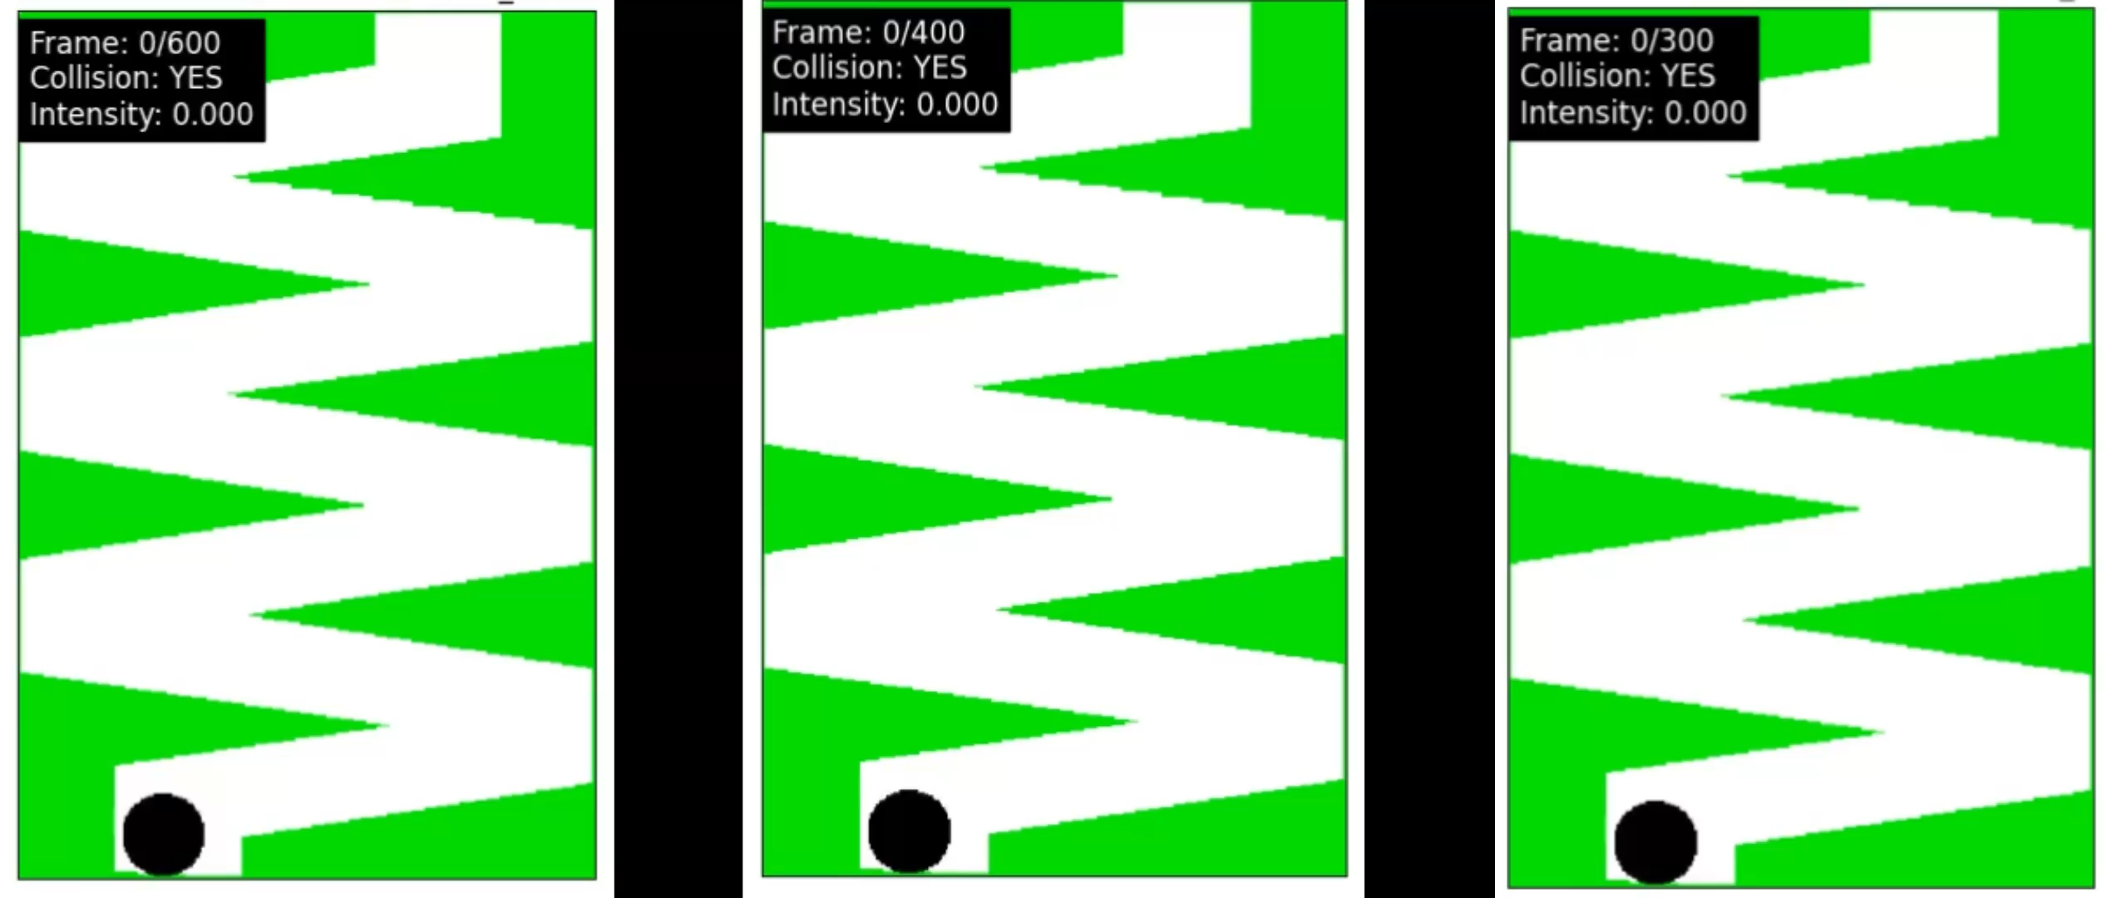
Cells on Tracks
WP MODEL
WPI MODEL
WPI-PIP3 MODEL
Edwin Huras

Slide 38
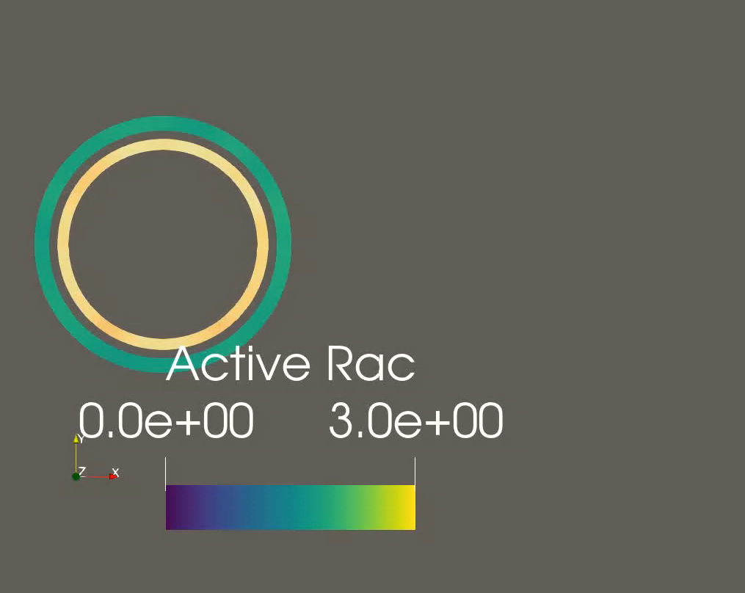
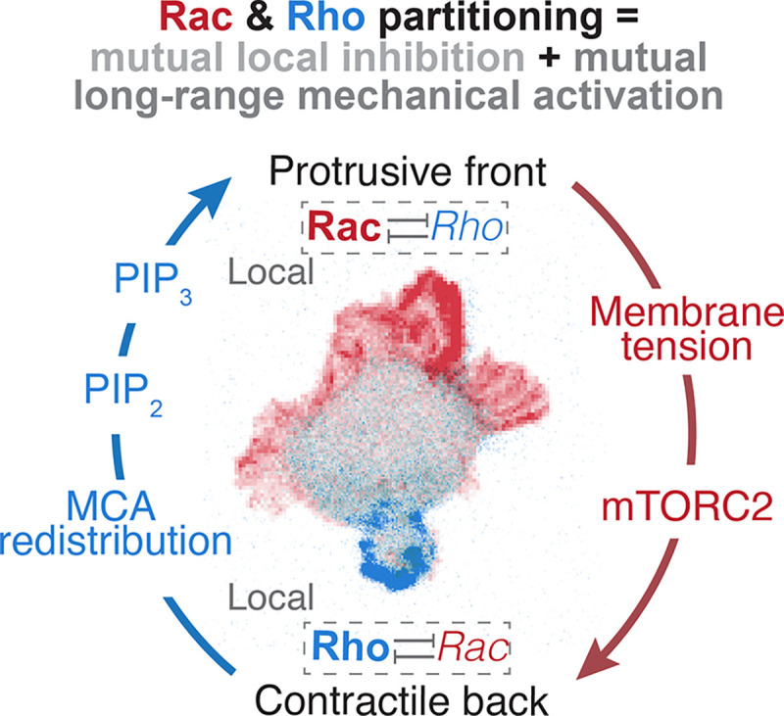
Finite Elements (Multi-mesh)
Henry De Belly et. al., 2025

Slide 39


The end
How Do Cells Decide Where to Go?
28 May 2025
Modelling Migrating Cells
May 13, 2026
39

Slide 41
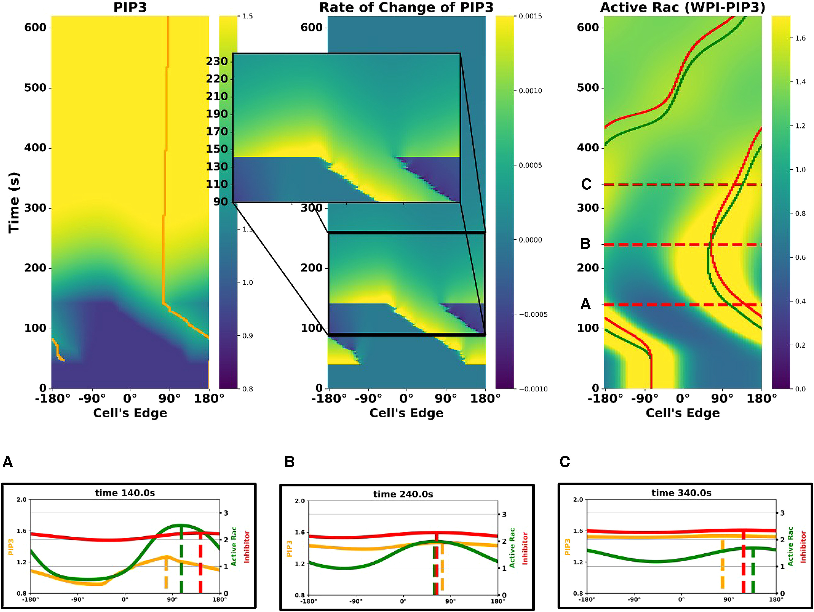

Slide 42
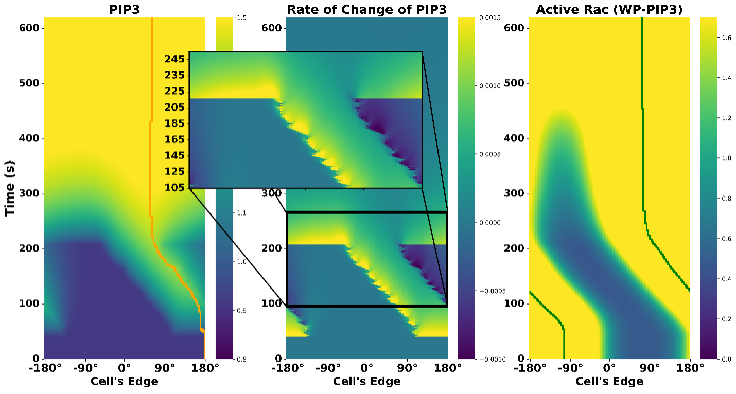
Extra stuff

Slide 43
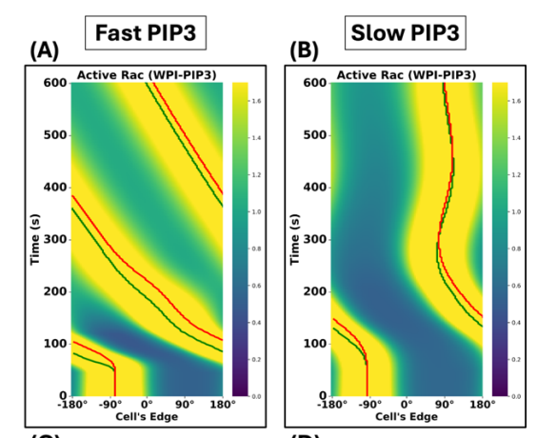
Extra stuff

Slide 44
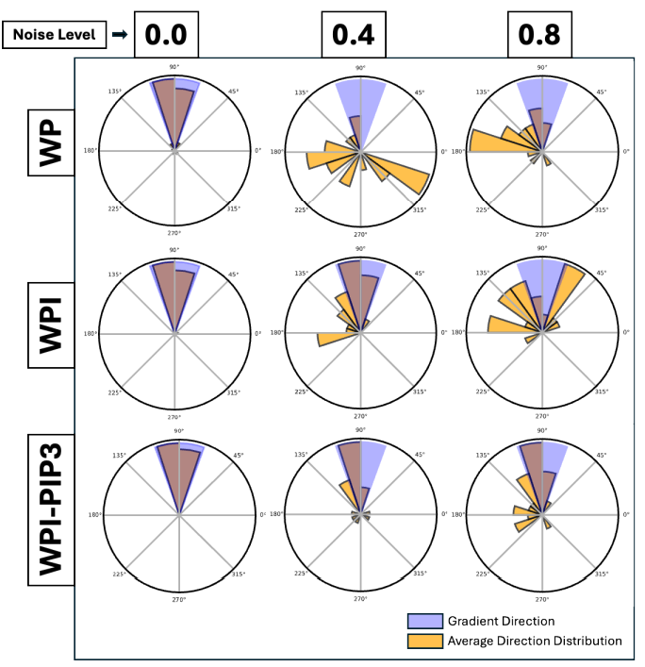
Extra stuff

Slide 45
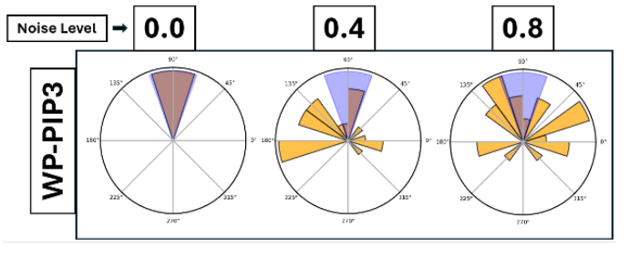
Extra stuff

Slide 46
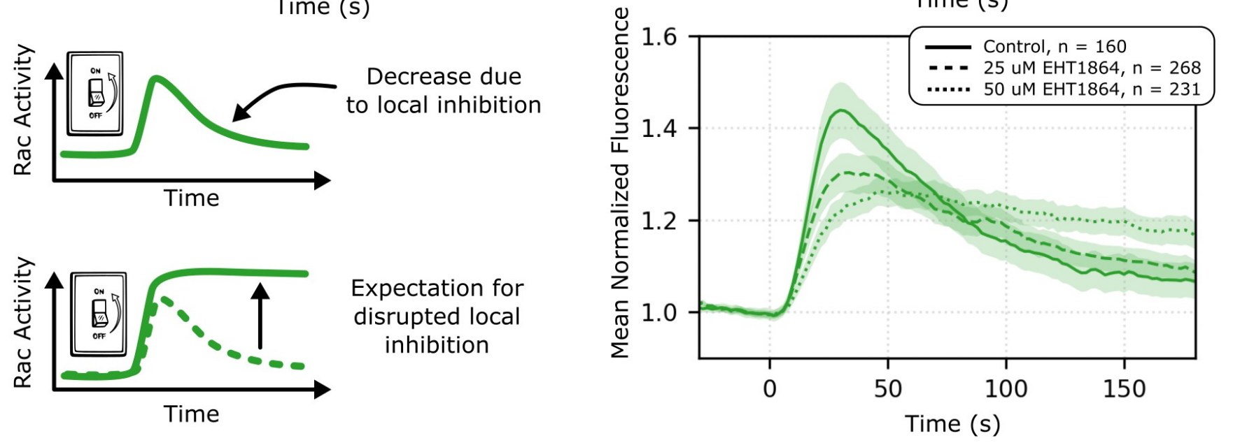

Slide 47
Active
Rac
Active
Rac
PIP3
GEF
GAP
PIP2
Inhibitor
GEF
GAP
Inactive
Rac
Inactive
Rac

Slide 48
Active
Rac
Active
Rac
GEF
GAP
GEF
GAP
Inactive
Rac
Inhibitor
Inactive
Rac

Slide 49
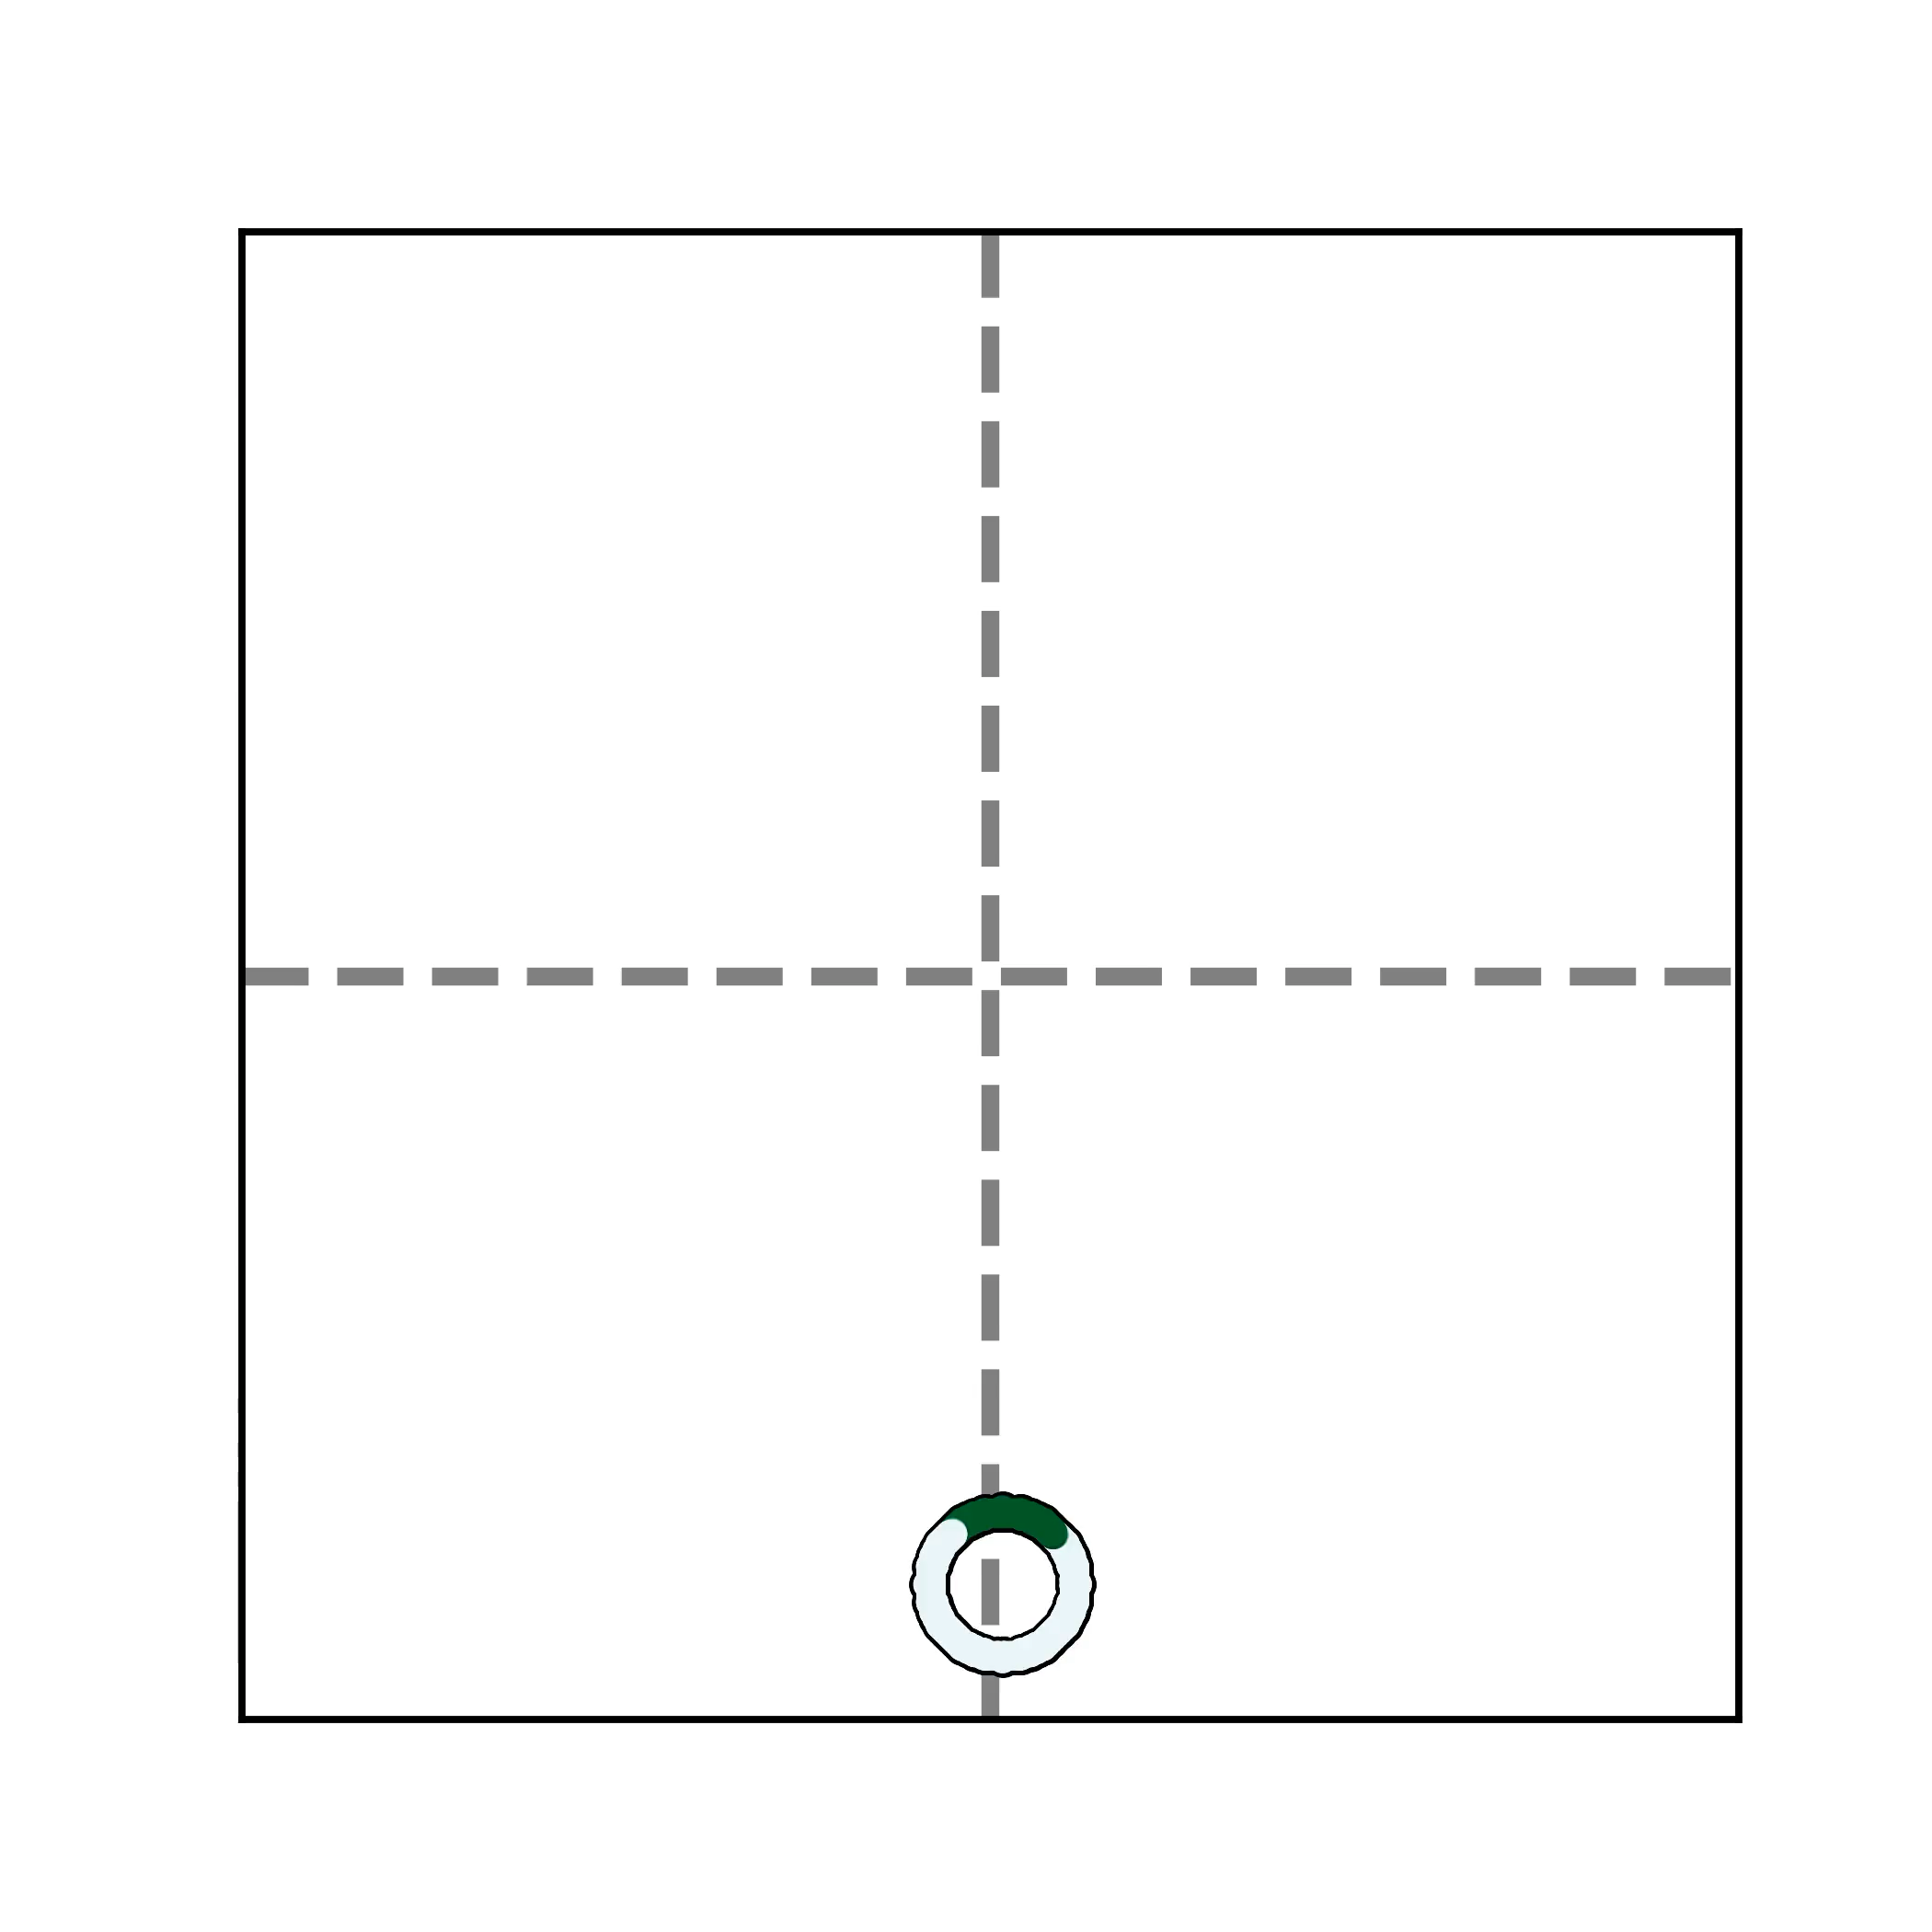
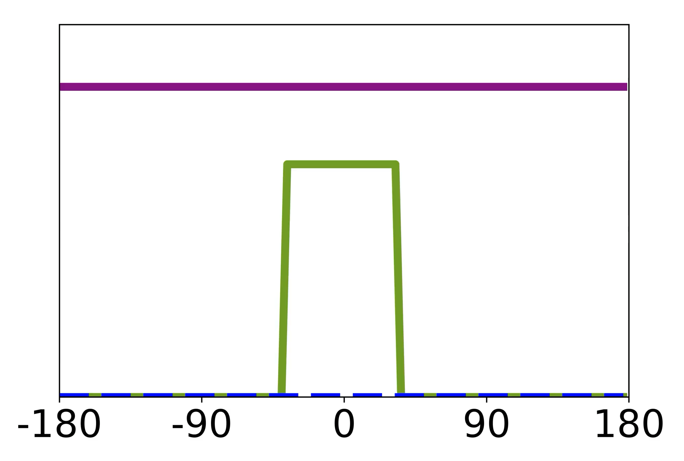
Wave-Pinning (WP) Model

Slide 50

How Do Neutrophil Cells Move at All?
Active
Rac
Protrusion
GEF
GAP
Inactive
Rac

Slide 51
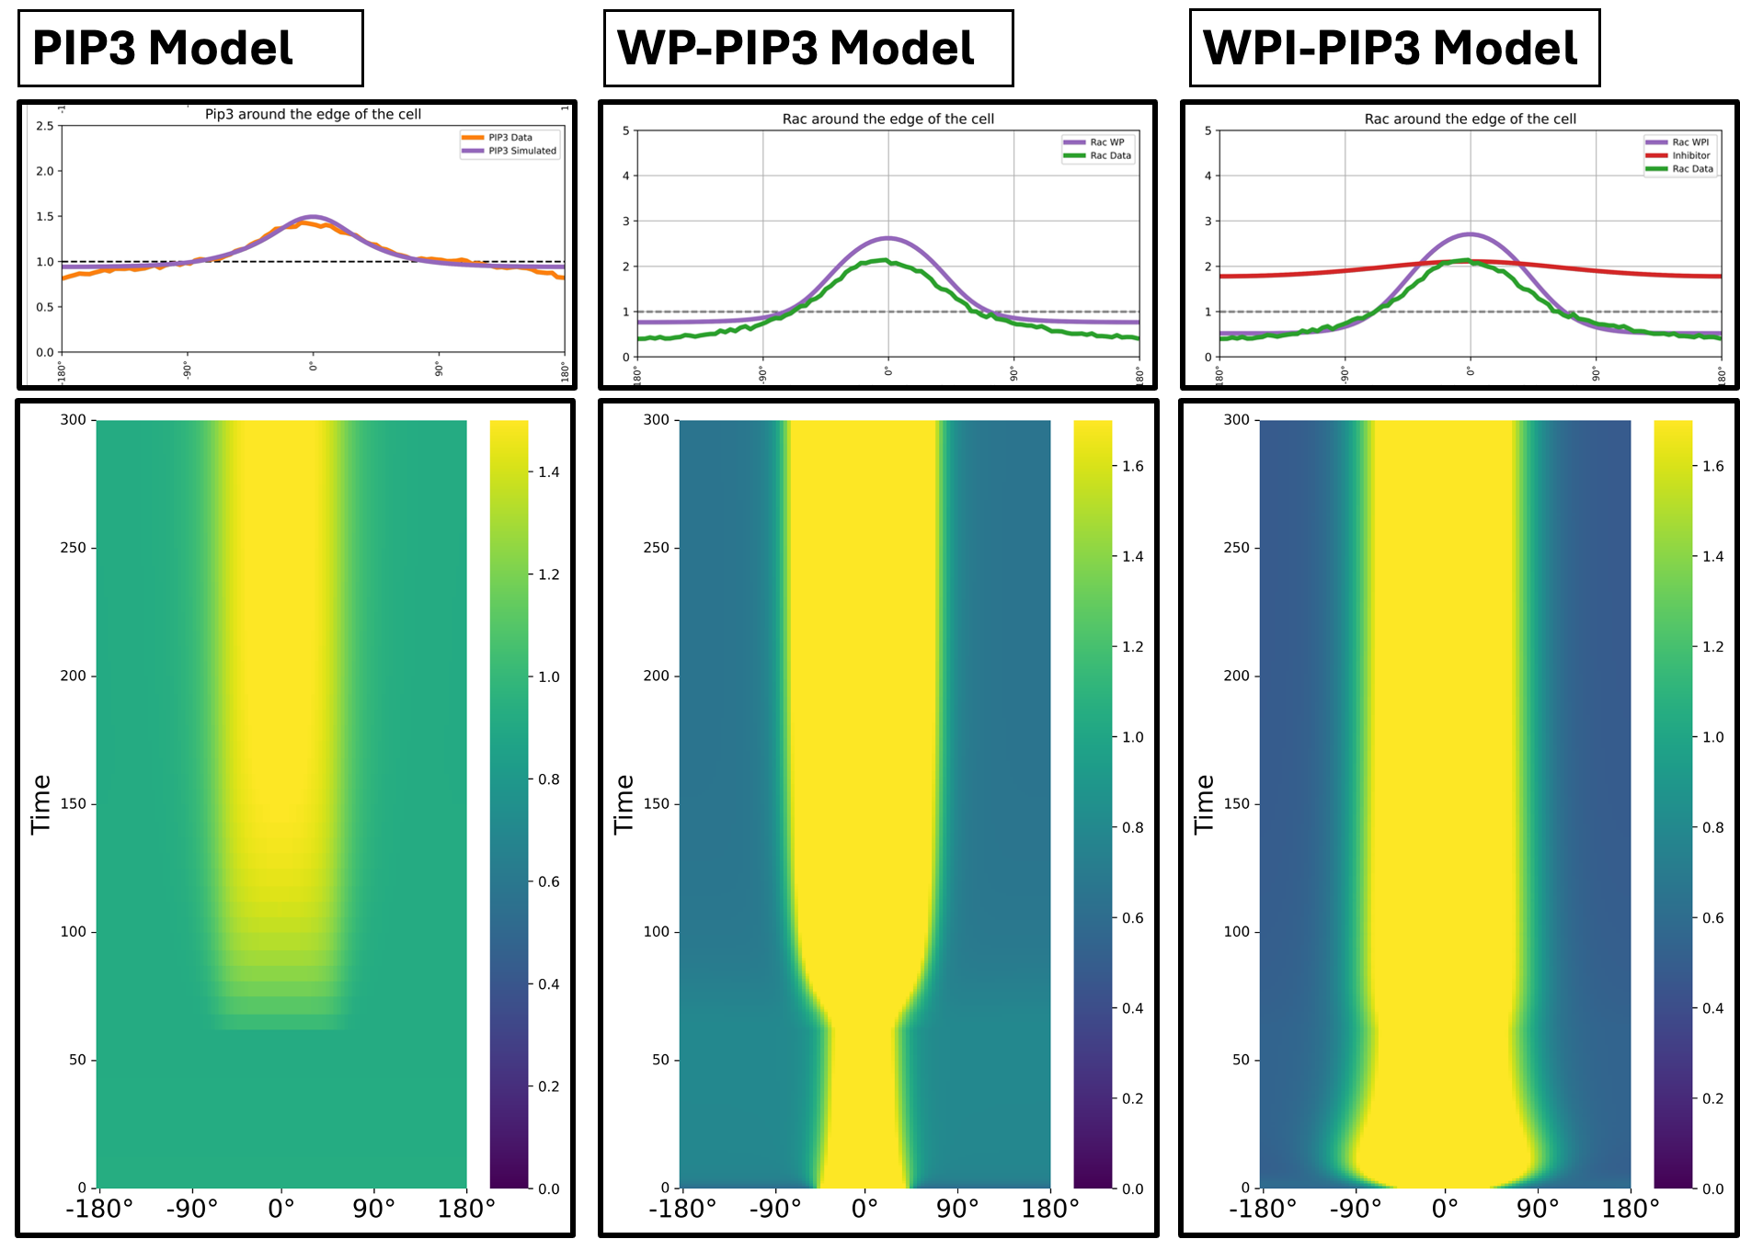
Fitting diffusion rates
Algorta J., Town, J.P., Weiner, O.D. and L.E.K., 2025

Slide 52
Back to Chemotaxis
Algorta J., Town, J.P., Weiner, O.D. and L.E.K., 2025

